Slide 1
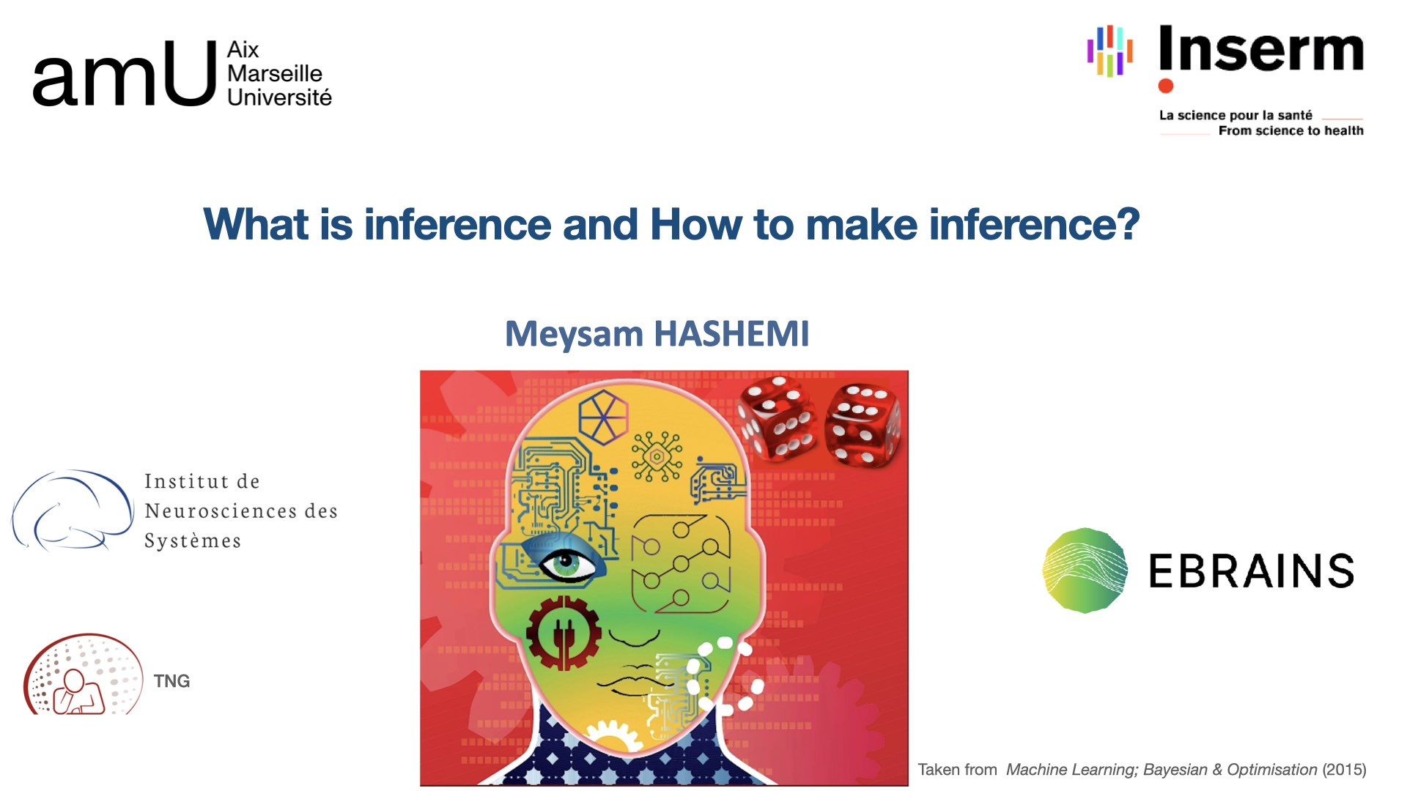

Slide 2
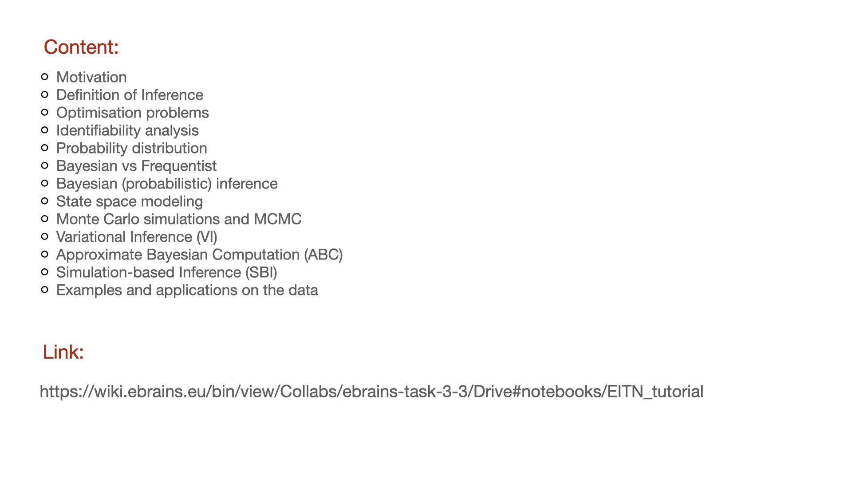

Slide 3

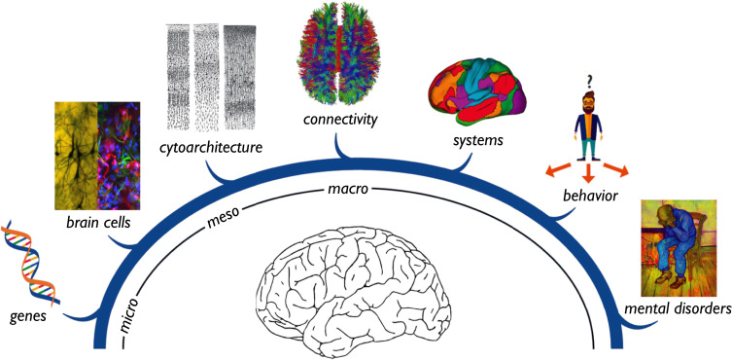
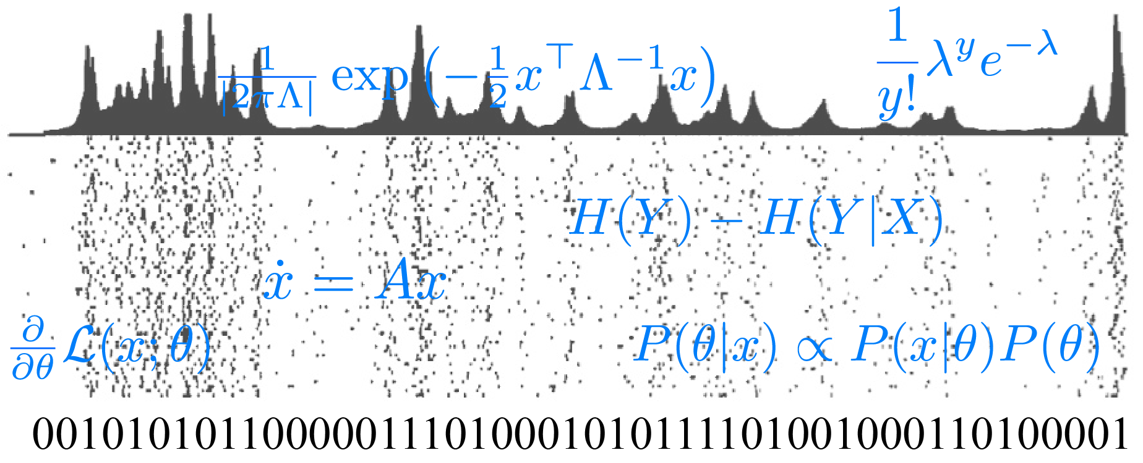
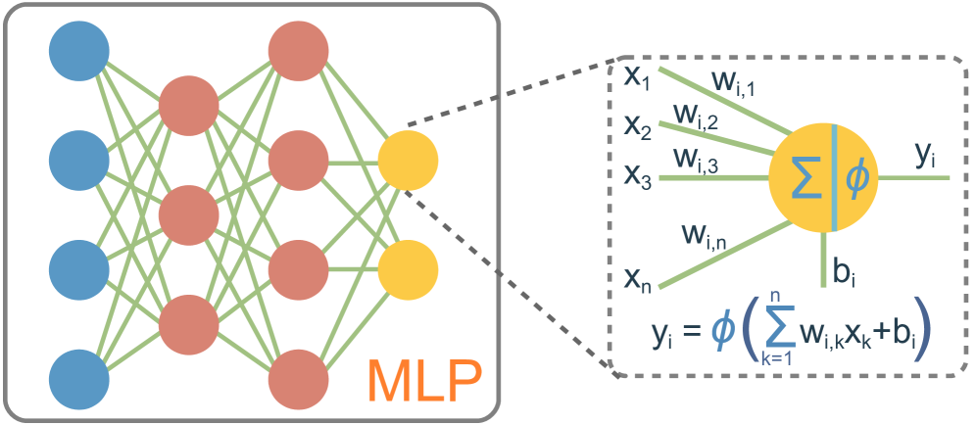

Objective
Data across spatiotemporal scales
So what?!
Heuvel et al., 2019
Models
Algorithms
Supercomputers
Not enough brain to survive. THOMAS LEROOY
How to extract actionable knowledge from resources.
Notes:
Today we have access to huge data, and tools such as model, algorithms, and supercomputer,
but the main question is how we can extract useful knowledge from these sources?
My objective is to build automatic and widely accessible inference tools, for clinical translation.
to improve diagnosis, treatment, and understanding of neurological and health conditions.
———————————————————
Making probabilistic inference and prediction widely applicable for studying health and brain diseases can significantly improve diagnosis, treatment, and understanding of neurological and health conditions.
With advances in data science, AI, and personalized medicine, achieving this objective can lead to more accurate predictions of disease progression, more targeted interventions, and overall better health outcomes

Slide 4
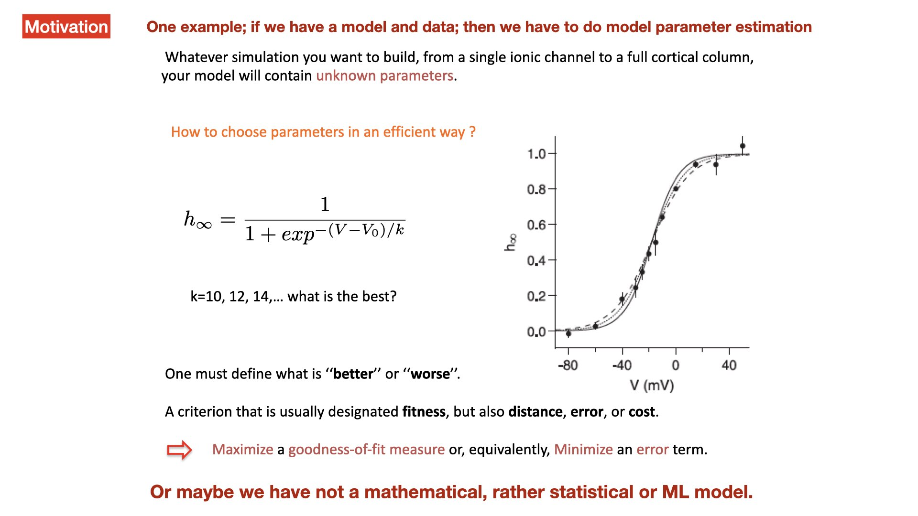

Slide 5
What is inference?

Slide 6
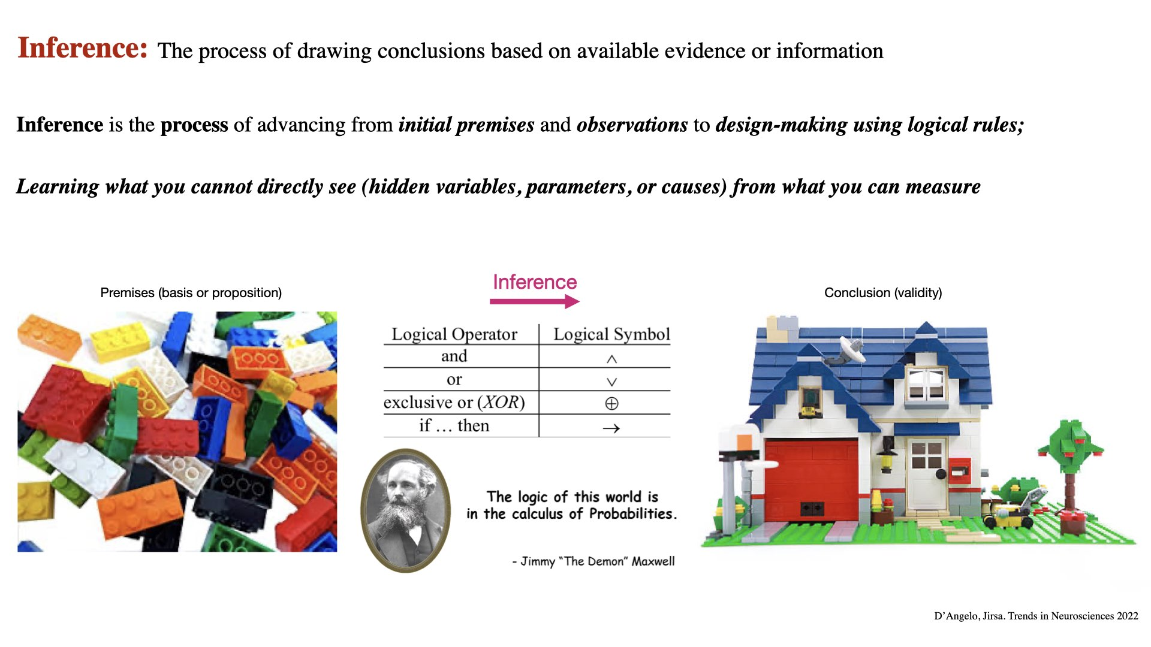
Notes:
Premise: basis for a theory or statement or proposition in an argument
Forward models: Bottom-up: estimating the effects, knowing the causes
Model inversion: Top-down: estimating the causes, knowing the effects

Slide 7
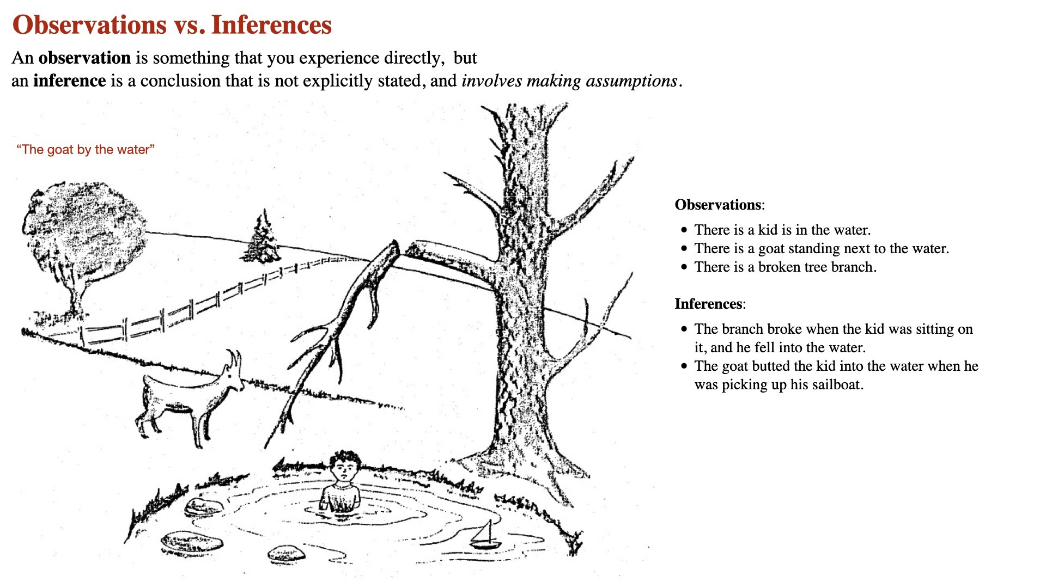

Slide 8
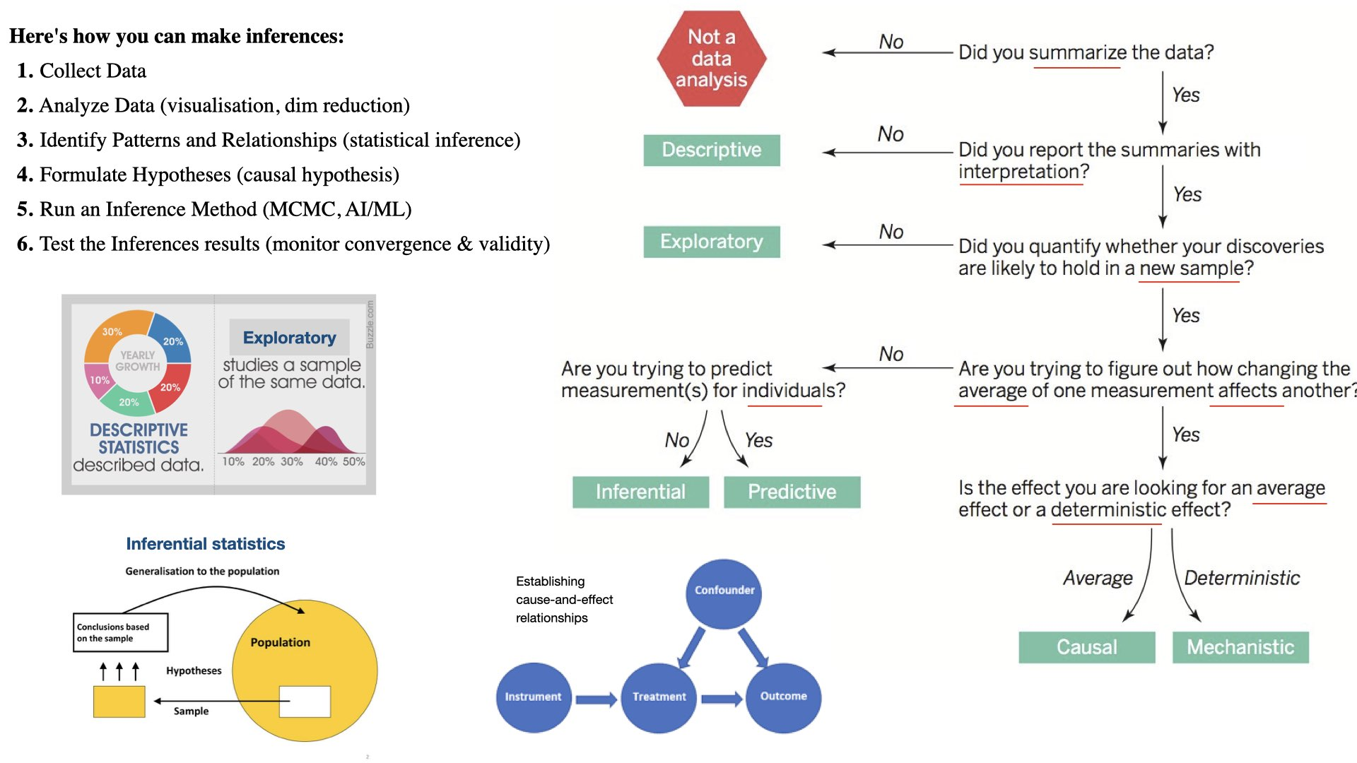
Notes:
Descriptive Inference: Describing the current state or characteristics of a situation based on data (summary presentation of data). For example, inferring the average age of a population from a sample of survey responses.
Inferential Inference: Testing statement or making generalizations (predictions) about a larger population based on data from a representative sample. This is common in statistics.
Predictive Inference: Making predictions about future events or outcomes based on historical or current data (individualised). For example, forecasting sales for the next quarter based on past sales data. This is common in machine learning.
Causal Inference: Determining cause-and-effect relationships between variables. Establishing causation often requires controlled experiments.

Slide 9
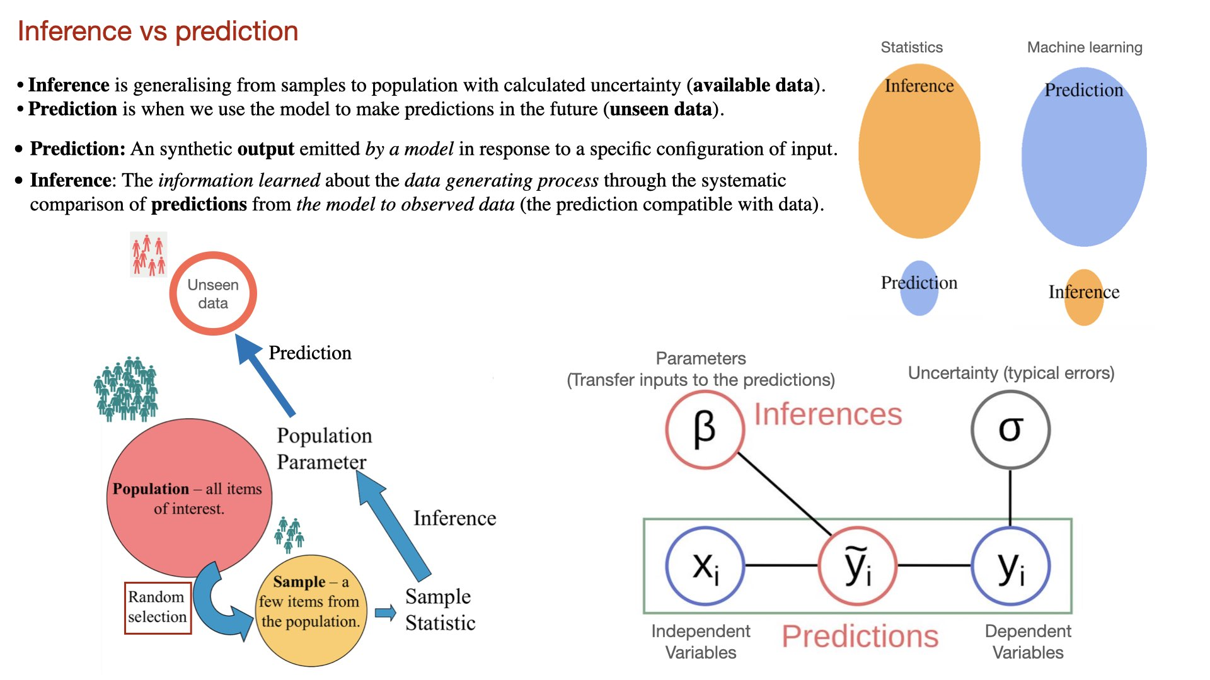
Notes:
Inference about population based on statics on some samples
The prediction represents the best fit of the model to the observed variable
A set of independent variables, x_i , that are observed and provided to the model as input data or “predictors.”
A dependent variable, y_i, that is also observed and provided to the model as training examples of output data.
Predictions, synthetic output data that are generated by the model and intended to match as well as possible.
A set of inferred parameters, beta, that serve to transform the inputs into the predictions.
An uncertainty measure, sigma, that characterizes the magnitude of typical errors in predictions.

Slide 10
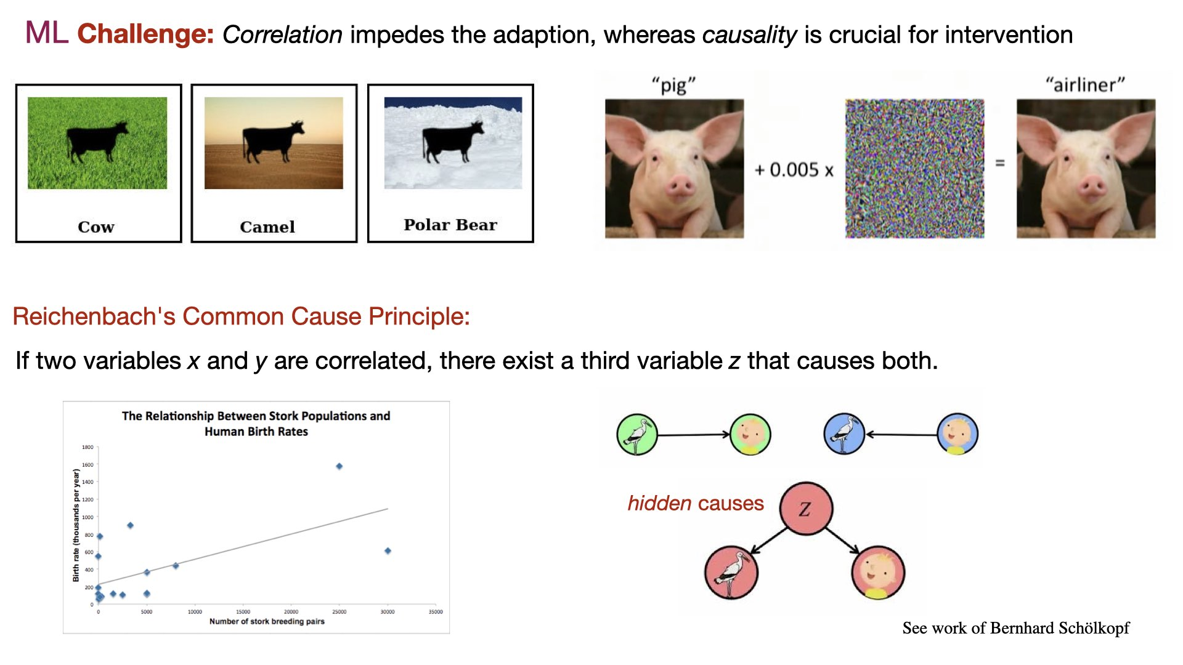
Notes:
Inference is the process of advancing from initial premises to conclusion using logical tools. In other words, from data to decision making using algorithms.
However, there is a major challenge that ML is based on the spurious correlation.
Here we see examples of Background shift and Perturbation by pixel attack , which lead to misclassification.
These are Adversarial Vulnerability, as the model relies on irrelevant or spurious correlation (non-causal background features).
This allows to identify mechanisms and causality, and quantifying the uncertainty to know where we deviate from reality (expected value). Moreover we can integrate the clinical and anatomical knowledge for better prediction. This will maximise the model predictive power and potentially to improve the intervention.
At larger scale the goal is to improve public health.
———————————————————
The (top-down) process of drawing conclusions based on observation (available evidence or information) , involves making assumptions.
Inference is the process of advancing from initial premises and observations to logical conclusions by quantifying the uncertainty in a model and data, (using rules of logics, reasoning, algorithms, probabilities, …),
thus providing an objectification of the validity of the decision.
Inference allows us to simulate real-world systems, thus learning about the data generation process, making predictions on unseen data, and justifying the hypotheses.
providing evidence to support or refute hypotheses

Slide 11
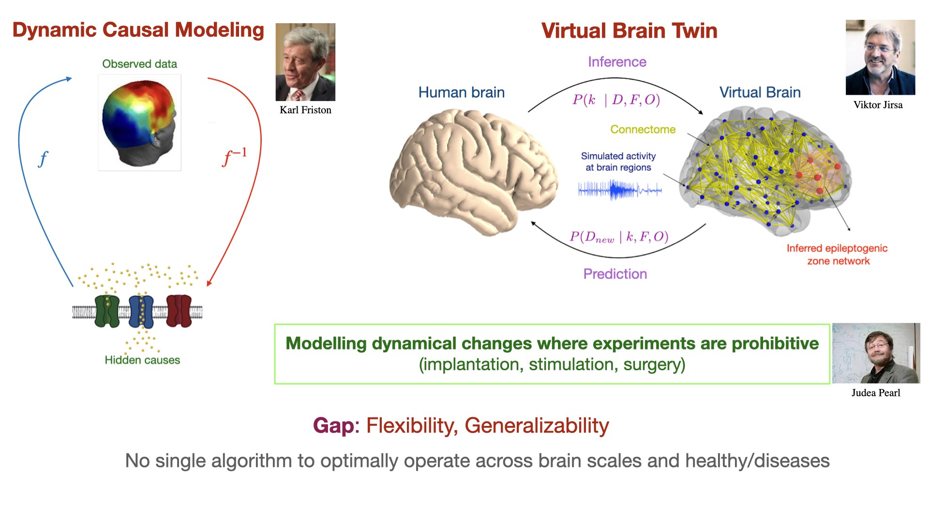
Notes:
The pioneer in field of neuroscience is DCM, in which we have often recording at macroscale and we use statistical models to infer causal mechanism hidden at synaptic level.
A recent transformative approach is VBT, in which we use inference and integrate the structural and functional brain data to build a personalized digital replica of an individual's brain. This has reached clinical translation in epilepsy eg., to estimate EZN, supporting clinicians in treatments and optimizing interventions.
Importantly, this allows for the modelling dynamic changes under conditions when the experiment is prohibitive. However, the gap is flexibility and generazibility as no single …
———————————————————
We access the human brain through imaging that is typically at macro scale, implying the need for a network level approach, but mechanisms are hidden at micro scale. Therefore wee need to link the scales to get the full picture (we need both).
Forward modeling, bottom-up approach, prediction of the effects based on the known causes
Inverse modeling, top-down strategy, infers hidden causes from observed effect.
I hypothesize that establishing an interpretable link across brain scales, with the aid of mechanistic models and deep learning algorithms would represent a significant advancement in computational neuroscience, particularly for the clinical applicability of virtual brain twins.
I will integrate my Bayesian ecosystem in EBRAINs a European infrastructure that offer ….but it lacks

Slide 12
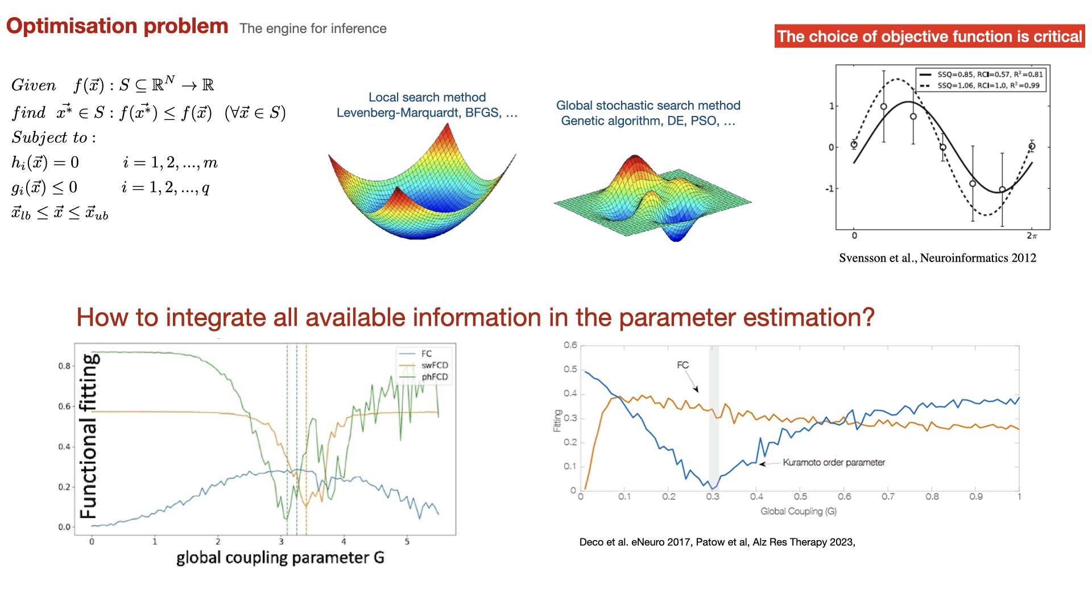

Slide 13
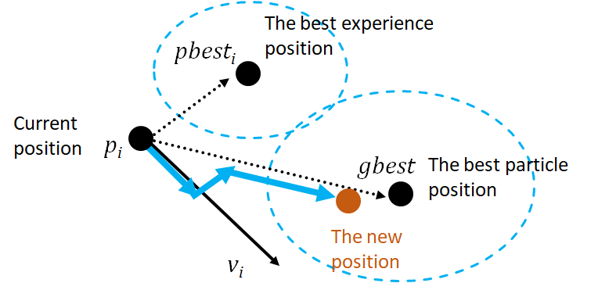


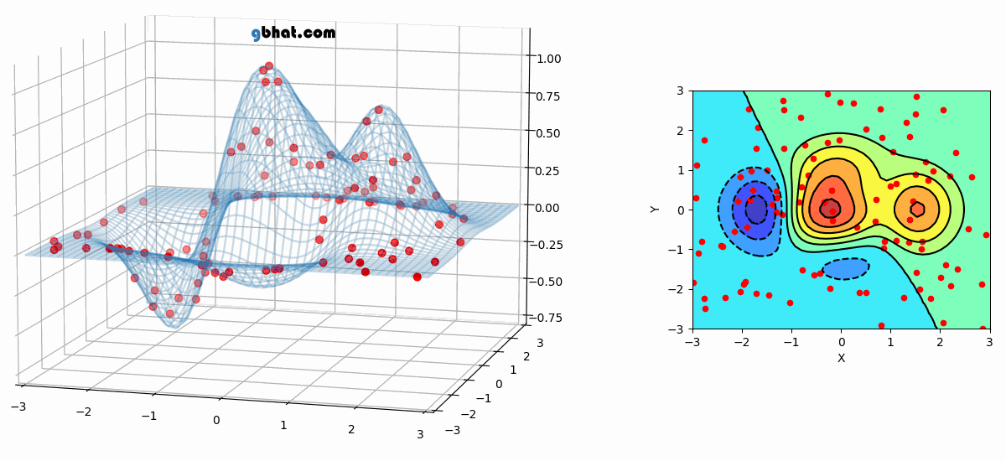
Particle Swarm Optimization (PSO);
Kennedy, Eberhart and Shi 1995 (social behaviour)
School of fish
Flock of birds
Often needs many particles.
There is a trade-off
between g_best local and global
(Exploration-Exploration)
Recommendation: PSO, DE and covariance matrix adaptation evolution strategy
(Numpy, scipy)

Slide 14
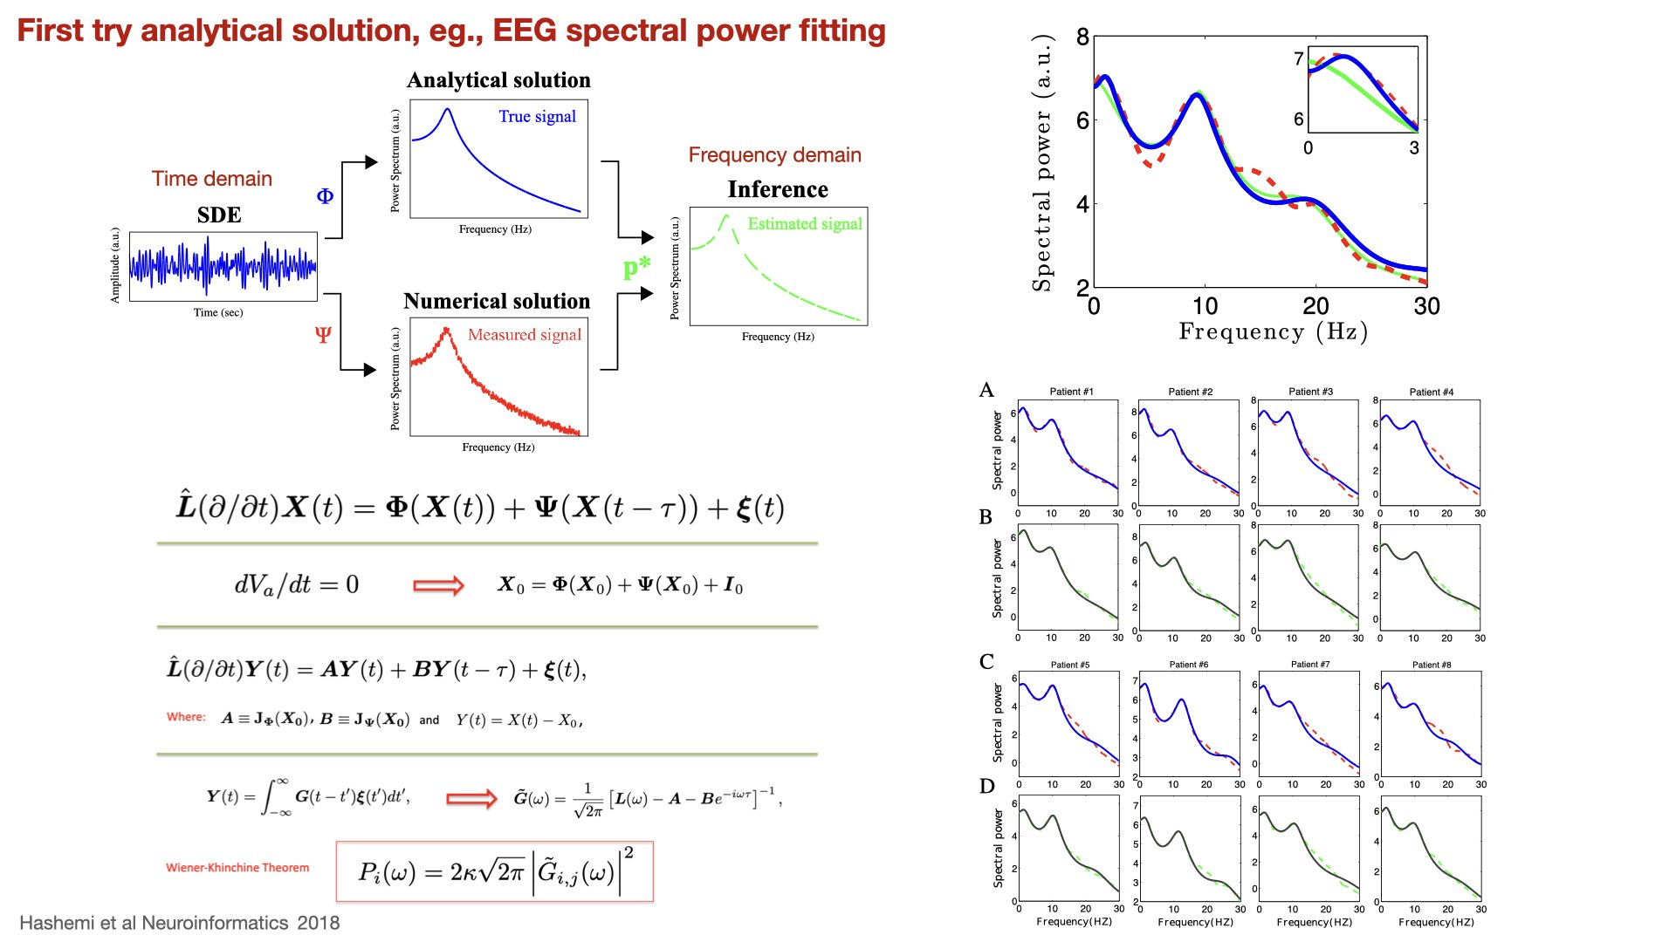
Notes:
We have proposed a novel method to estimate the parameters of ordinary and delay stochastic differential equations: instead of inference from time series,
the unknown parameters are estimated from the power spectrum of signal computed analytically using Green’s function method.
Schematic illustration of parameter inference carried out in this work. In Case studies I and II, to estimated the parameters of a SDE, the true signal (analytical power spectrum)
is fitted to the measured signal (numerical power spectrum). In a similar manner applied to real data measurement, in Case study III, the power spectrum of a neural mass model (true signal)
is fitted to the EEG-spectral power (measured signal).
As can be observed from the schematic illustration, in order to estimate the unknown parameters of a set of SDE, we transform the observation from time-domain to frequency-domain data.
To this end, the power spectrum of the system is computed analytically by the aid of Green function method to generate the true signal, i.e. the signal constructed
by the nominal (true) parameters. In addition, the system spectral power is calculated numerically to acquire the measurement signal. Then, the model parameters
are estimated by fitting the measurement signal to the corresponding true signal.
Under the assumption of spatial homogeneity, the system equations do not depend to spatial locations and obey the general form of functional DDEs, where those terms that have delay are separated from those term without delay.
Vector X is the activity variable here, and bold capital L is a diagonal matrix including all temporal operators L.
By setting all the temporal derivative to zero, the resting state of the system can be obtained. Then by linearizing the system equations around the resting state yields the the following form of linear DDE, where Y is deviation from resting state, and A and B computed from Jacobian matrices at fix point X_0 are constant quadratic matrices.
Substituting a solution in this form of Y in above and applying Fourier transform, we arrive at the Fourier transform of matrix Green’s function G.
Finally applying Wienner-Kninchine Theorem gives the spectral power density (the power spectral density of a stationary process is the Fourier transform of its autocorrelation function )
Where we have assumed that the EEG is generated by the activity of pyramidal cells and by virtue of the specific choice of external input to relay cells, the EEG power spectrum depends to only one component of Greens function.

Slide 15
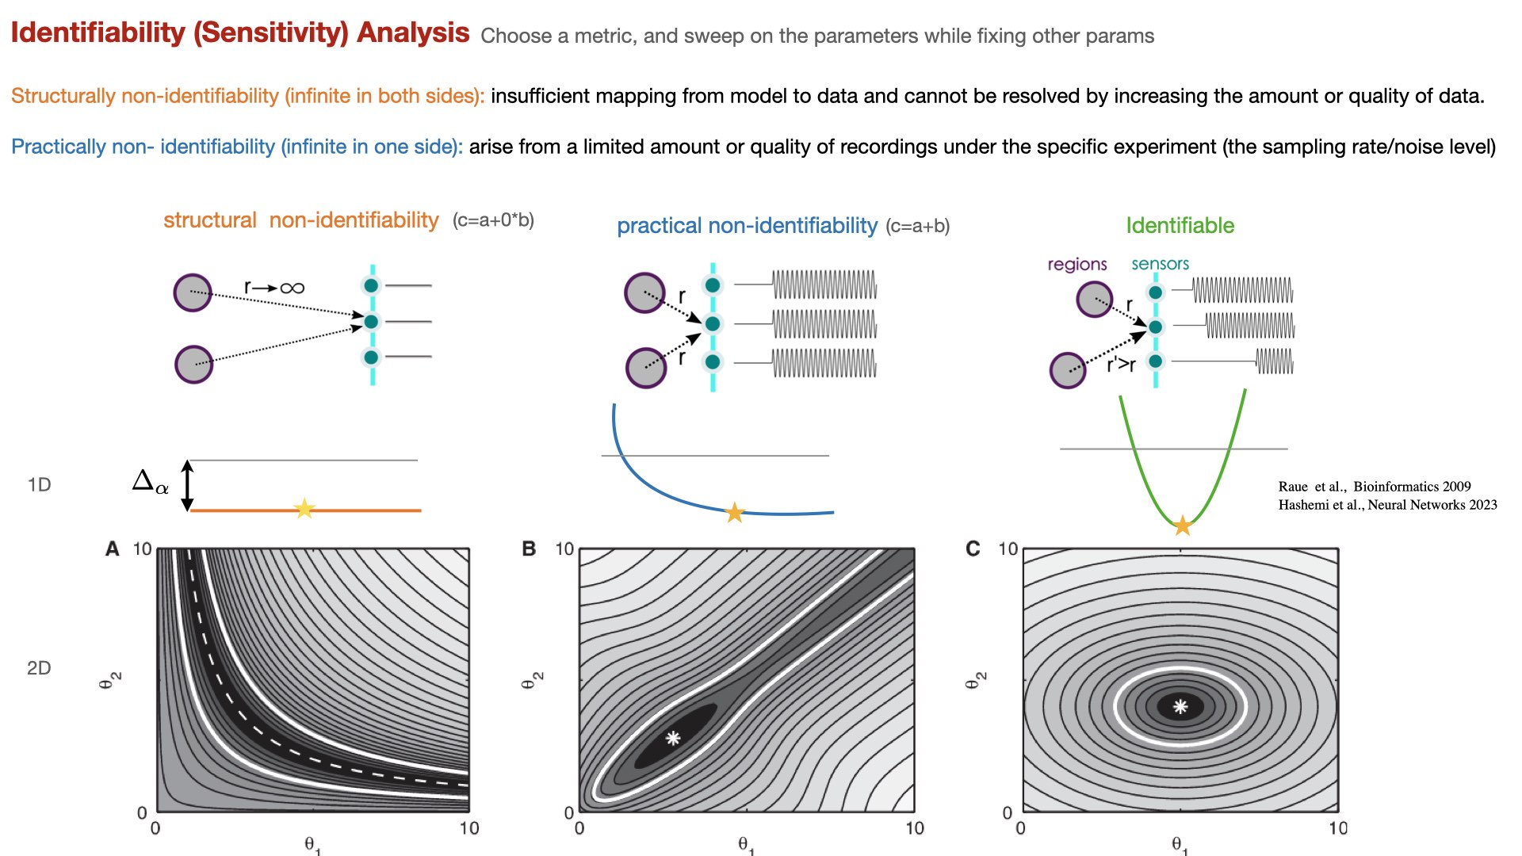

Slide 16

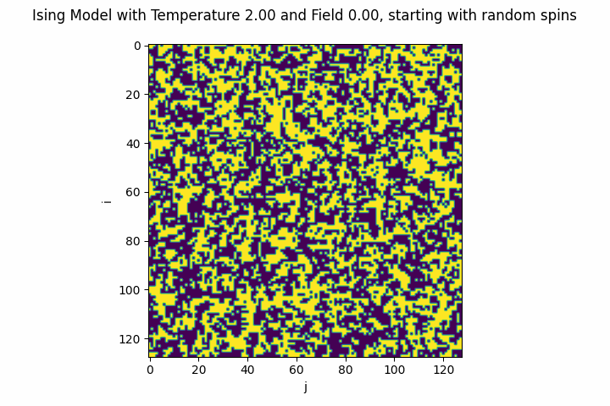
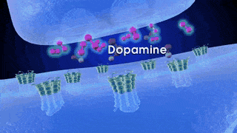
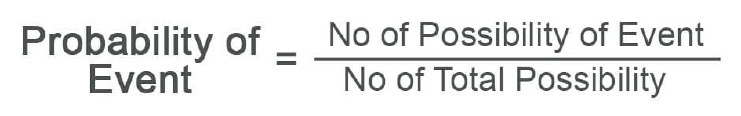
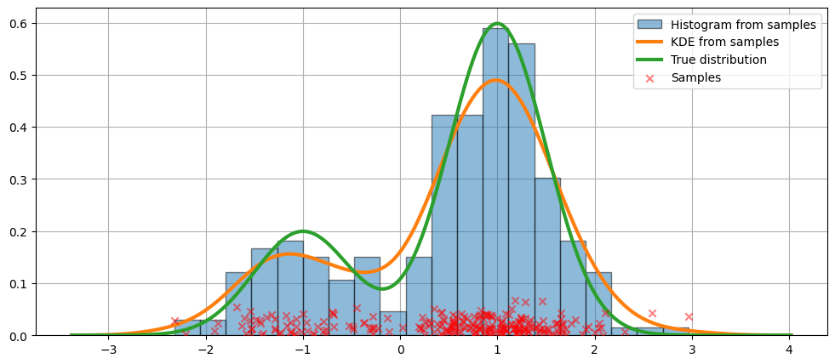
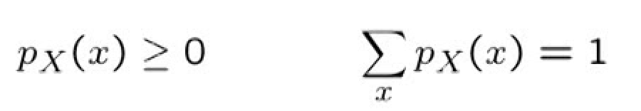
A stochastic system refers to a system or process that inherently incorporates randomness:
Weather Patterns, Thermal fluctuations, Genetic Mutations, Neuronal Firing, Neurotransmitter Release, …
synaptic transmission
A probability distribution is a mathematical function that assigns probabilities (likelihoodness) to different outcomes or events:
So naturally quantify and characterize the randomness and uncertainty.
How probability of measurements are distributed
The time to get a taxi cab={6,3,4,6,2,3,2,6,4,4}; then
P(x=6 min)=3/10, P(x=2 min)=2/10
but what is the probability of P(x=1 min)?
Notes:
p_X
X: randome variable
P(Y=y)
Y: the actual outcome of en event
y: one of possible outomes
P(Y=2)=P(2)=1/6
Stochastic systems inherently involve randomness and uncertainty, and probability distributions are a natural way to quantify and characterize this randomness.
Probability Distribution: A probability distribution is a function that describes how the values of a random variable are distributed. It assigns probabilities to each possible outcome of the random variable.
A probability distribution is a list of outcomes and their associated probabilities (shape). A function that represents a discrete probability distribution is called a probability mass function. A function that represents a continuous probability distribution is called a probability density function.
A probability density distribution is a type of probability distribution used for continuous random variables. It represents the probability of a random variable taking on a specific value within an interval. The integral of the PDF over an interval gives the probability that the random variable falls within that interval. Probability Density Distribution (PDF) specifically refers to the distribution of continuous random variables and uses PDFs to model the probabilities associated with intervals of values.
In the absolutely continuous case, probabilities are described by a probability density function, and the probability distribution is by definition the integral of the probability density function.
The central limit theorem (CLT) is a fundamental concept in probability theory and statistics. It states that when independent random variables are summed or averaged, regardless of the shape of their individual distributions, the resulting distribution tends to approximate a normal distribution as the number of variables increases

Slide 17
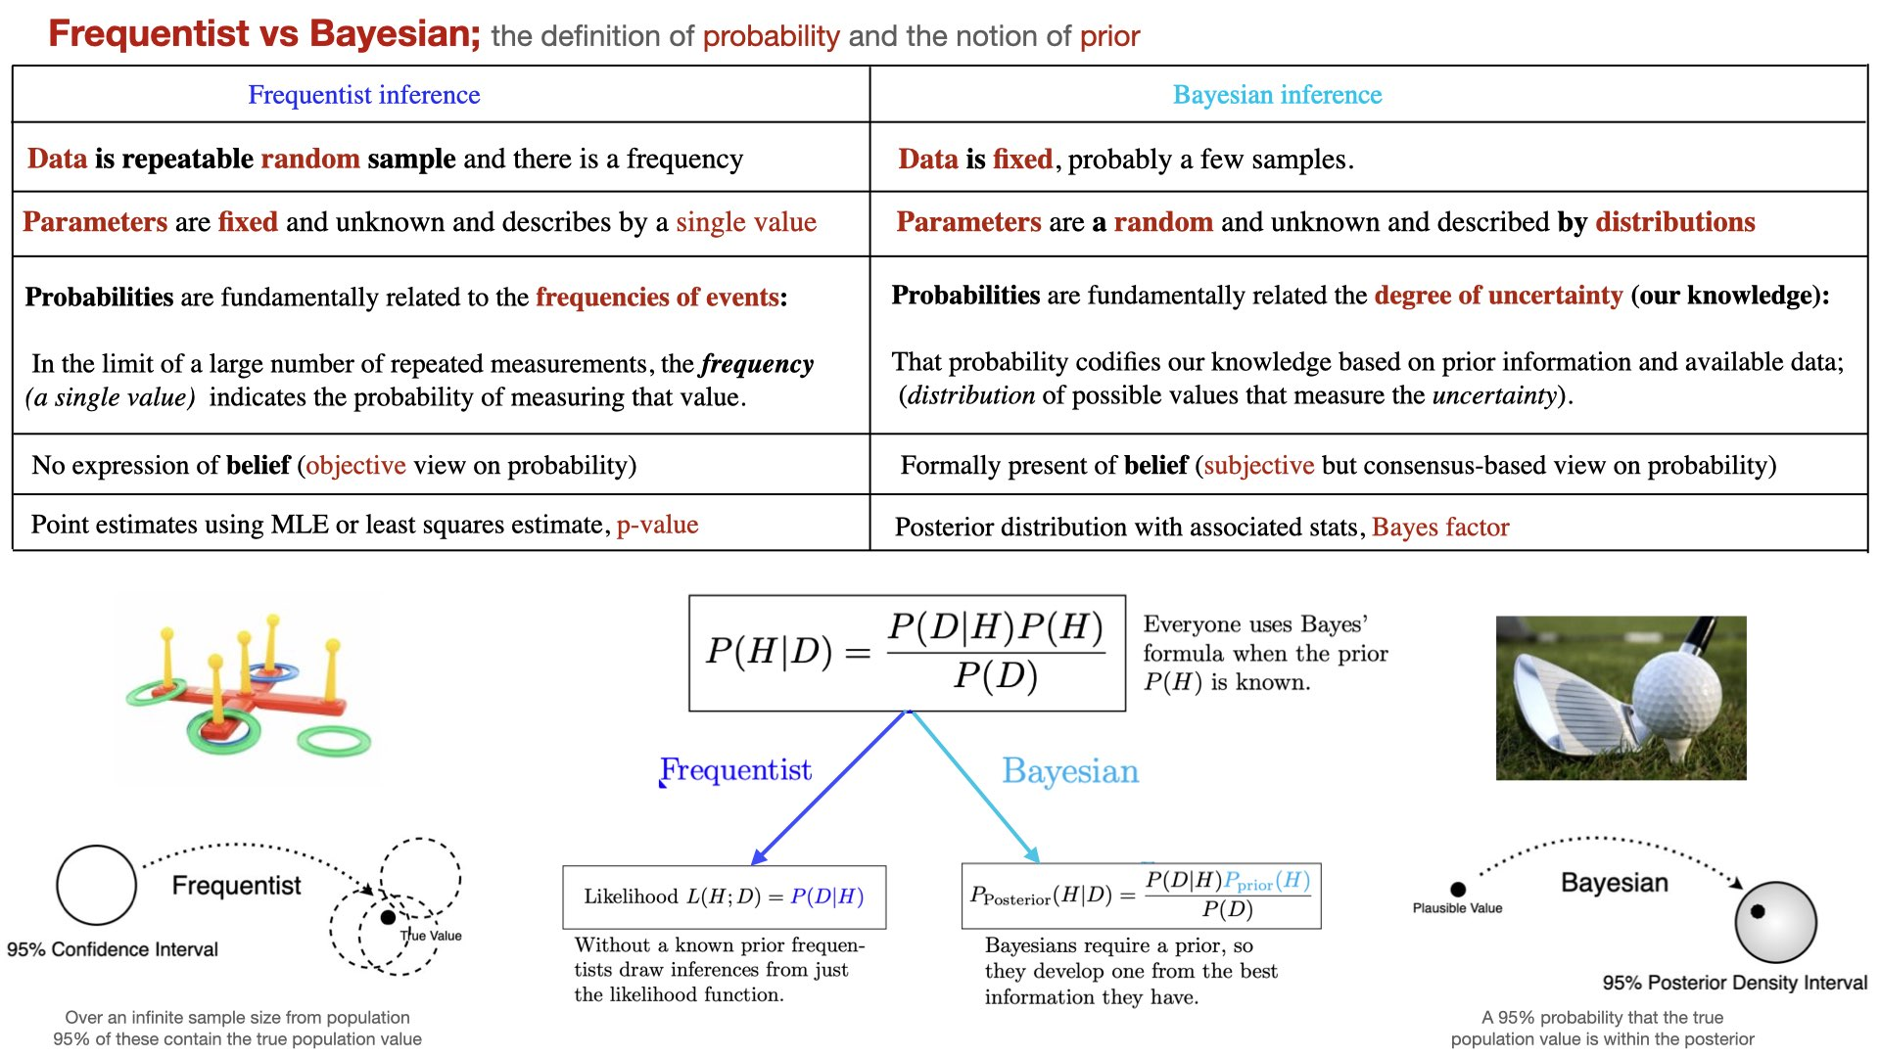
Notes:
there are two different approaches to solve the inverse problem: frequentism and Bayesianism.
In the Bayesian framework the probability is never just a frequency (single value), but a distribution of possible values.
Fundamentally, the disagreement between frequentists and Bayesians concerns the definition of probability.
For frequentists, probability only has meaning in terms of a limiting case of repeated measurements.
That is, if I measure the photon flux F from a given star, then measure it again, then again, and so on, each time I will get a slightly different answer due to the statistical error of my measuring device. In the limit of a large number of measurements, the frequency of any given value indicates the probability of measuring that value. For frequentists probabilities are fundamentally related to frequencies of events. This means, for example, that in a strict frequentist view, it is meaningless to talk about the probability of the true flux of the star: the true flux is (by definition) a single fixed value, and to talk about a frequency distribution for a fixed value is nonsense.
For Bayesians, the concept of probability is extended to cover degrees of certainty about statements. Say a Bayesian claims to measure the flux F of a star with some probability P(F): that probability can certainly be estimated from frequencies in the limit of a large number of repeated experiments, but this is not fundamental. The probability is a statement of my knowledge of what the measurement result will be. For Bayesians, probabilities are fundamentally related to our own knowledge about an event. This means, for example, that in a Bayesian view, we can meaningfully talk about the probability that the true flux of a star lies in a given range. That probability codifies our knowledge of the value based on prior information and/or available data.
We'll make the reasonable assumption that errors are Gaussian. In a Frequentist perspective, error is the standard deviation of the result of a single measurement event in the limit of repetitions of *that event*. In the Bayesian perspective, error is the standard deviation of the (Gaussian) probability distribution describing our knowledge of that particular measurement given its observed value)
Frequentist probability defines an event's probability as the limit of its relative frequency in a large number of trials.

Slide 18
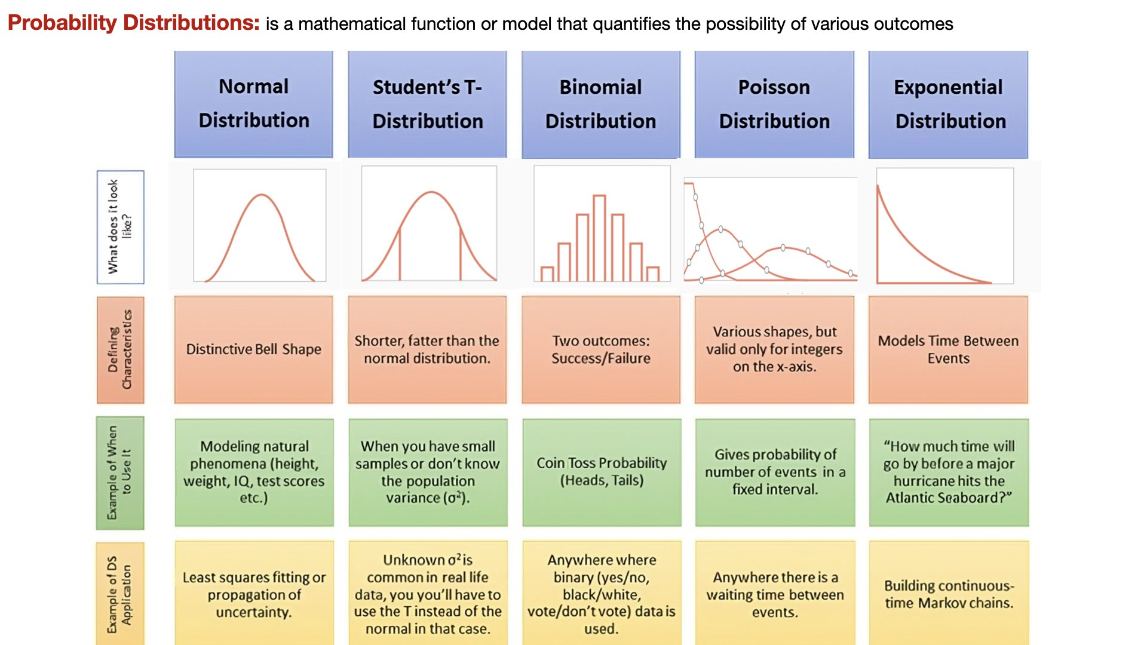
Notes:
A probability distribution is a mathematical function or model that describes the likelihood of various outcomes or values occurring for a random variable. In other words, it provides a way to assign probabilities to different possible events or values of a random process or experiment.

Slide 19
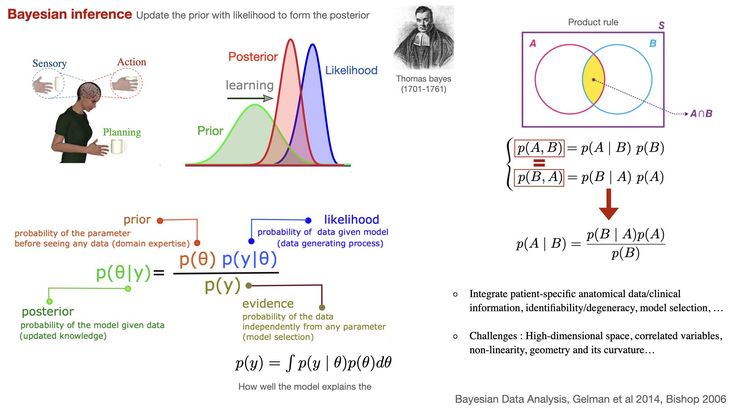
Notes:
A rule for updating beliefs based on the fact that the probability of two events occurring together is the probability of the first event, assuming the second has occurred, times the probability of the second event occurring (and vice versa); P(x2, x1)=P(x1|x2) P(x2)=P(x2|x1) P(x1)
Model evidence: How well we can explain the data

Slide 20
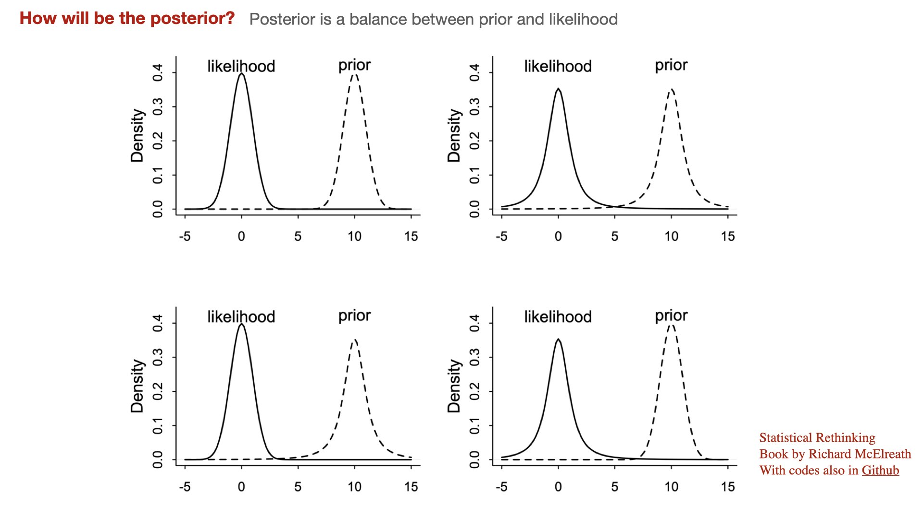

Slide 21
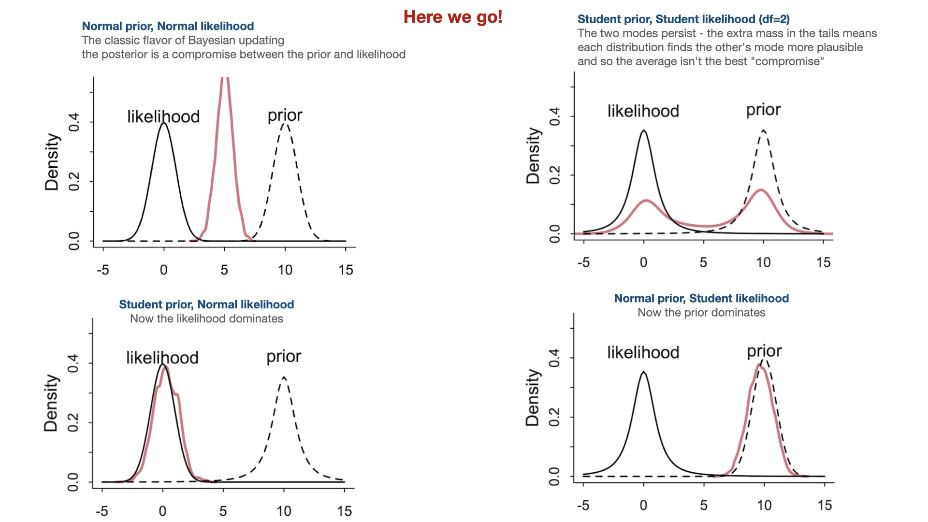

Slide 22
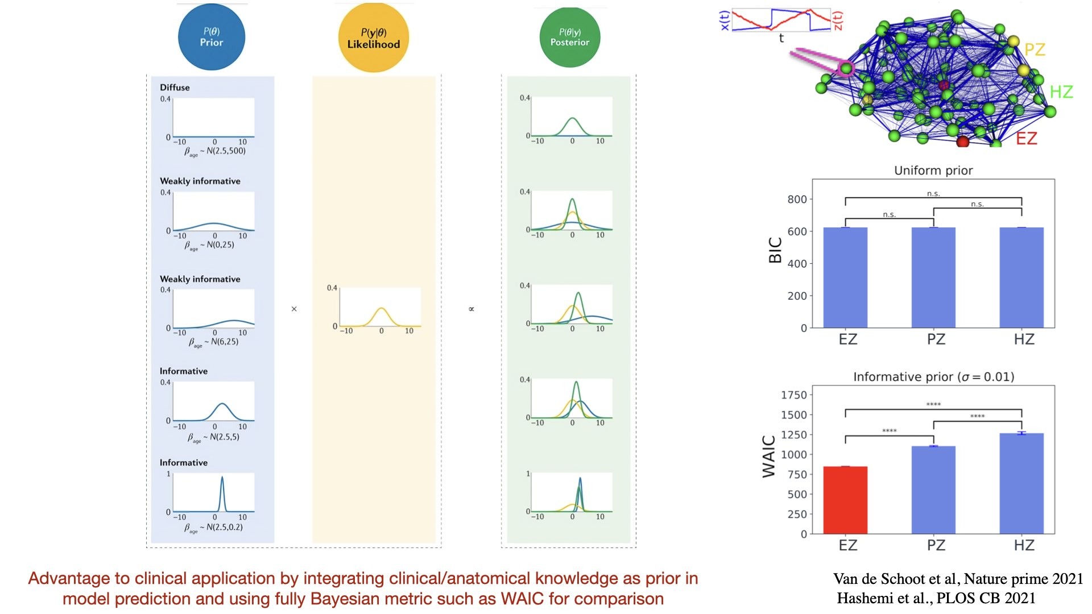
Notes:
How data relates data relates to our parameter

Slide 23
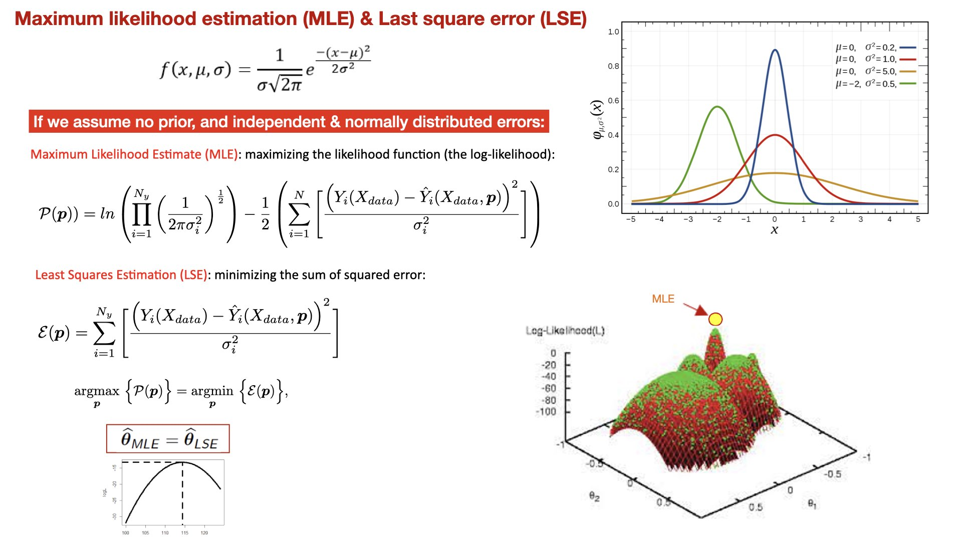
Notes:
The likelihood function is the probability of obtaining the set of observed data, with a given set of parameter values. The set of parameters which maximizes the likelihood function is called the maximum likelihood estimator (MLE).
If the error residuals are assumed to be uncorrelated and normally distributed (the measurement errors are uncorrelated with Gaussian distribution) the MLE assesses the quality of estimated parameters by maximizing the likelihood function (or equivalently the log-likelihood function which is easier to work mathematically).
Since the error terms are assumed to be independent, the combined likelihood of all the measurements can be written as a product.
maximizing the likelihood is equivalent to maximizing the log-likelihood function.
LSE involves a minimisation over of a suitable objective function that measures the distance (or discrepancy) between model.
if we assume additive uncorrelated Gaussian noise on the measurements, maximizing the log likelihood is equivalent to minimizing the sum of squared residuals between the model simulations and the experimental data.

Slide 24
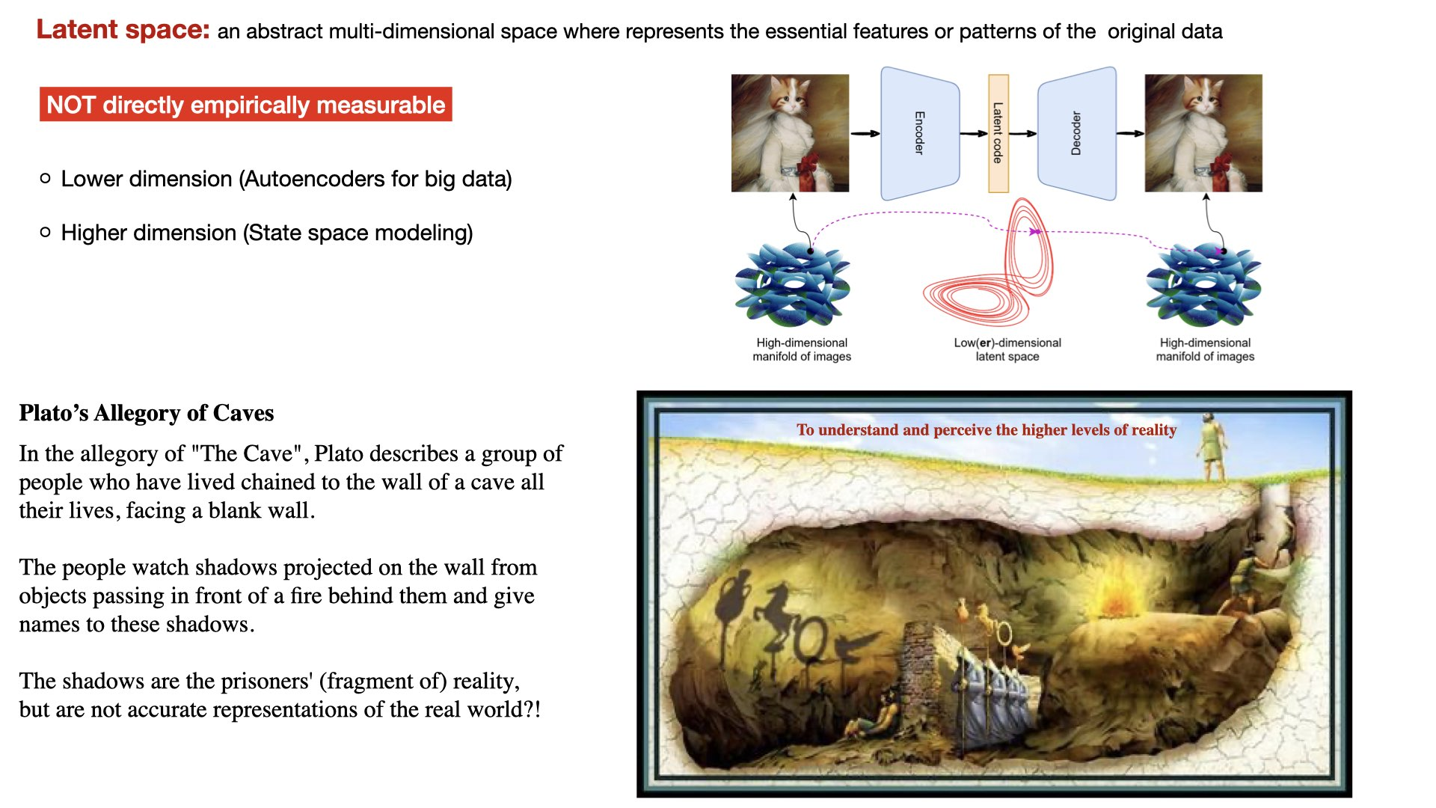
Notes:
encodes a meaningful internal representation of externally observed events
Allegory ( symbolic representation): As a literary device or artistic form, an allegory is a narrative or visual representation in which a character, place, or event can be interpreted to represent a hidden meaning with moral or political significance.
The Allegory of the Cave, or Plato's Cave, is an allegory presented by the Greek philosopher Plato in his work Republic (514a–520a) to compare "the effect of education (παιδεία) and the lack of it on our nature".

Slide 25
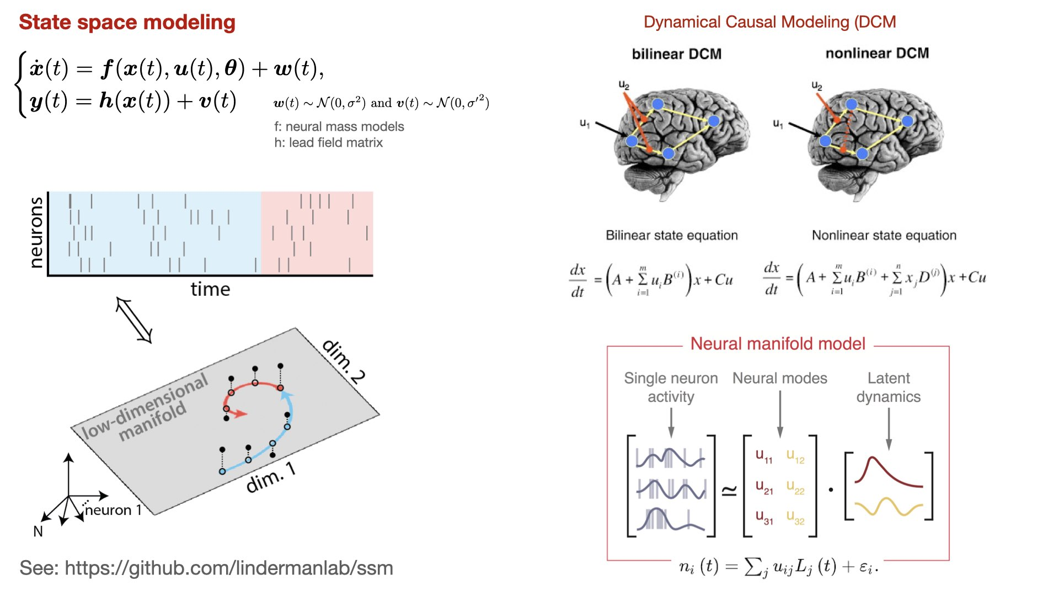

Slide 26
How to make inference?

Slide 27
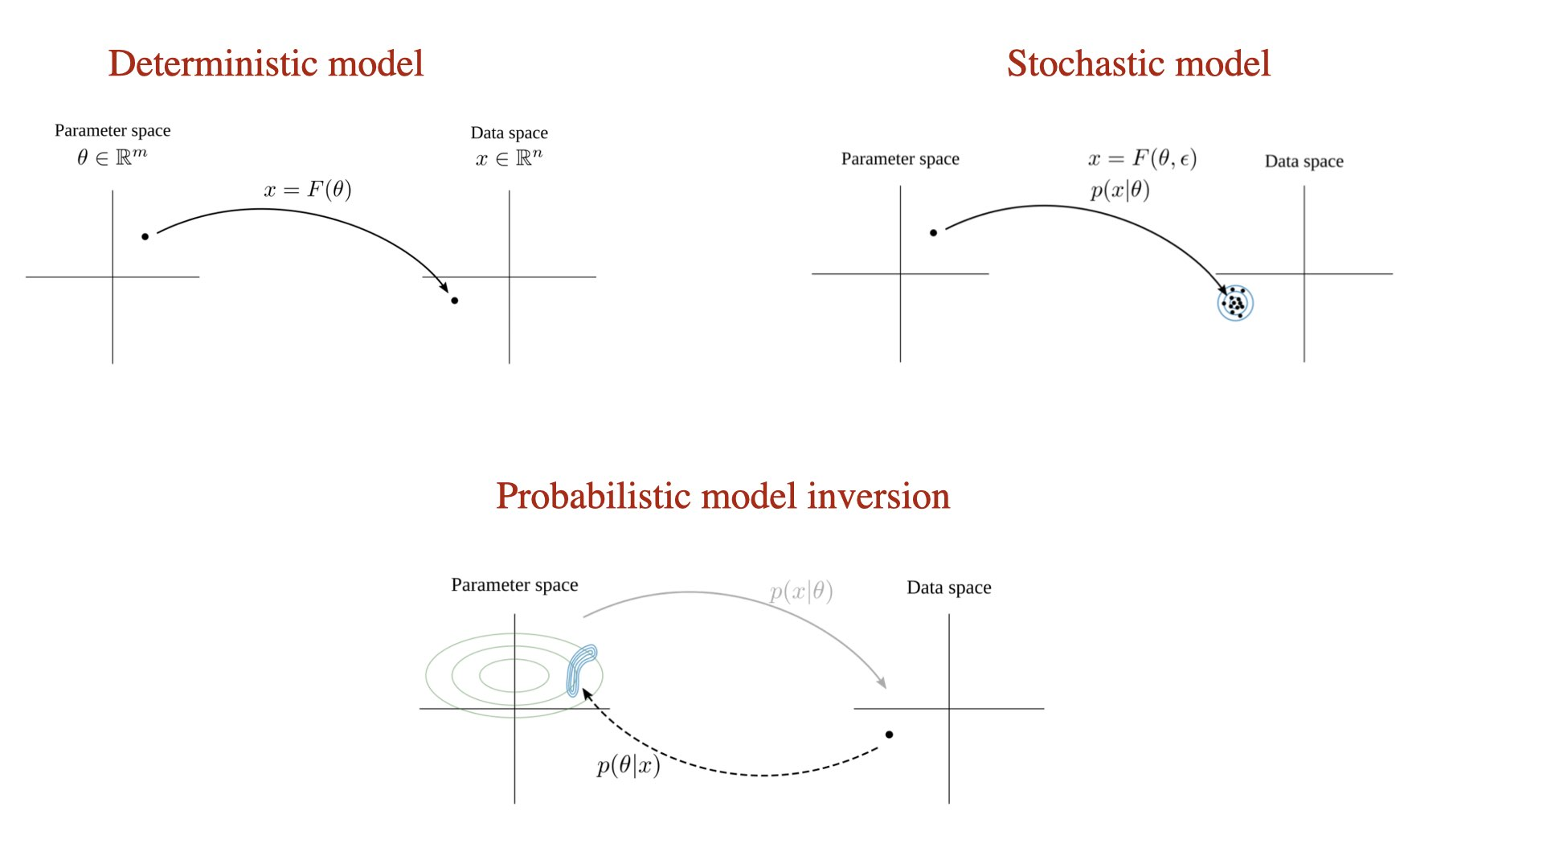
Made by Viktor Sip

Slide 28
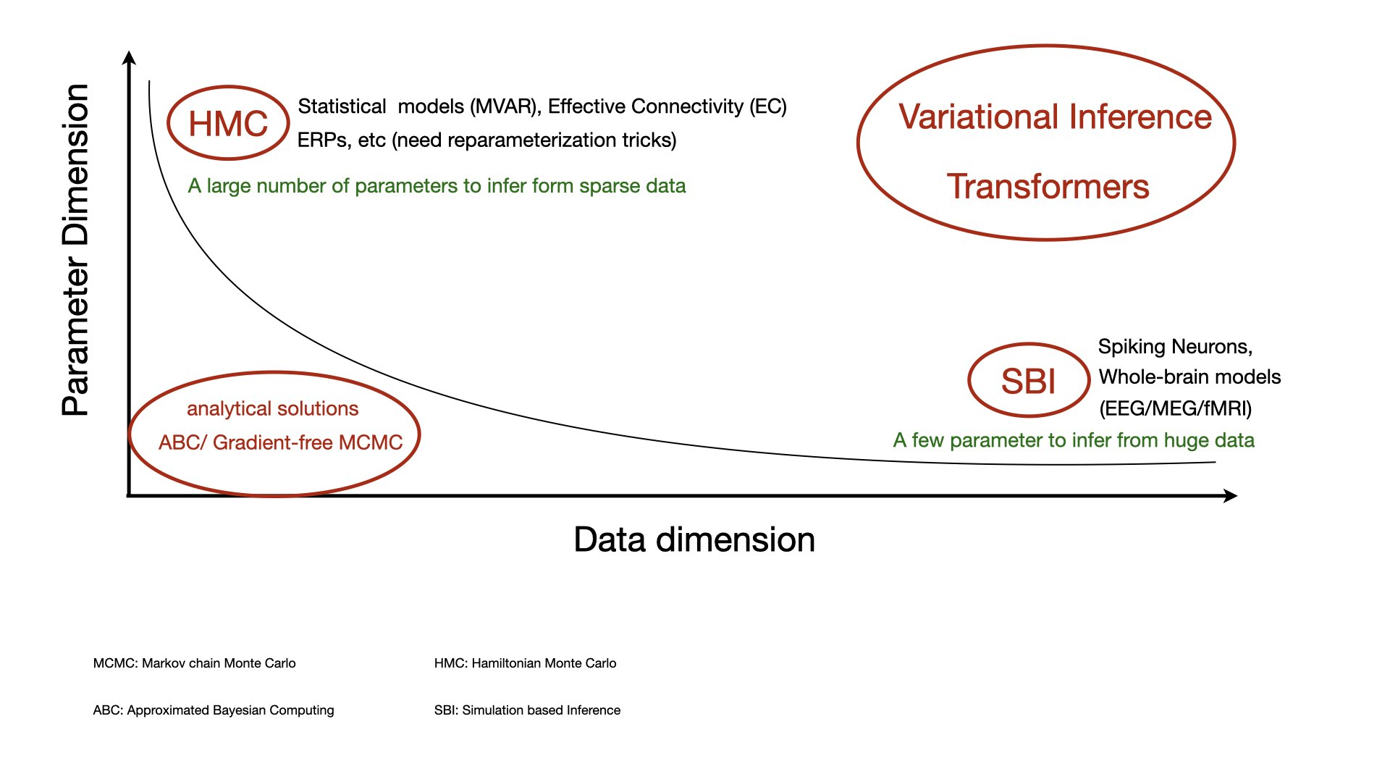

Slide 29
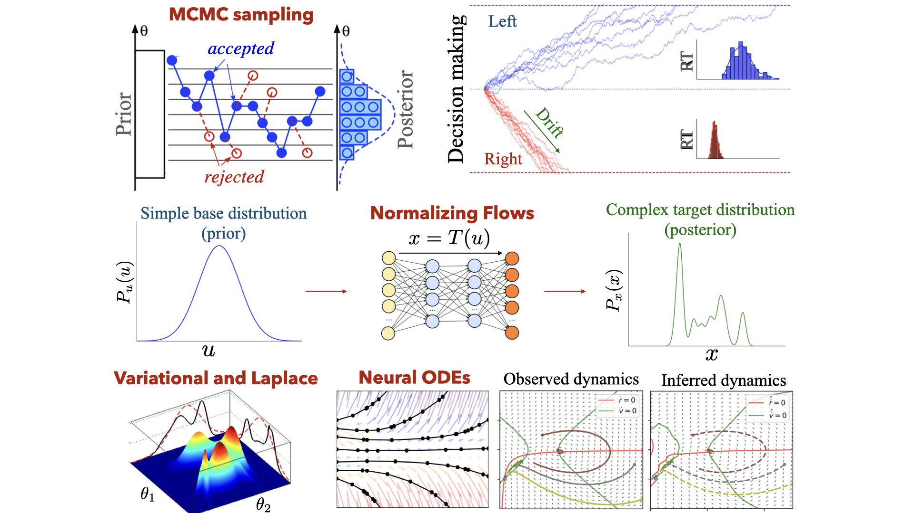

Slide 30
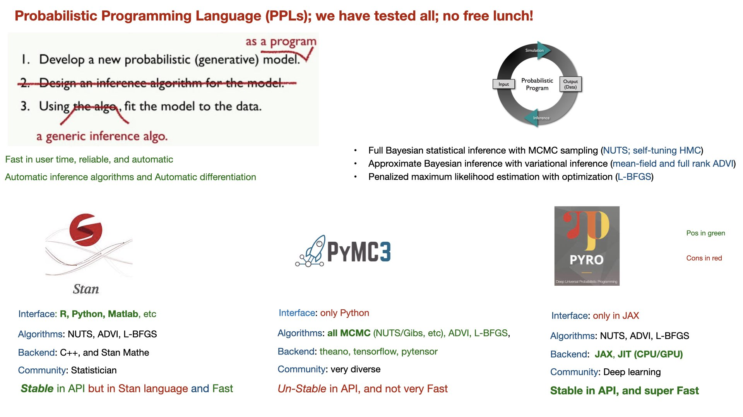
Notes:
We have large data set and complex models, thus we need complex inference to achieve rich inference. This leads to probabilistic programming (automated inference).
Stan is a flexible probabilistic programming system. Stan describes a high-level language to define probabilistic models as well as a model compiler, a library of transformations, and an
efficient automatic differentiation toolbox.
In Stan, the scientist only provides a probabilistic model and a dataset, nothing else.
PyMC3 is a Python package for Bayesian statistical modeling and Probabilistic Machine Learning which focuses on advanced Markov chain Monte Carlo and variational fitting algorithms.
Theano is a Python library that allows you to define, optimize, and evaluate mathematical expressions involving multi-dimensional arrays efficiently, especially ones with multi-dimensional arrays.
Using Theano it is possible to attain speeds rivaling hand-crafted C implementations for problems involving large amounts of data.
Theano is a library that allows expressions to be defined using generalized vector data structures called tensors.

Slide 31
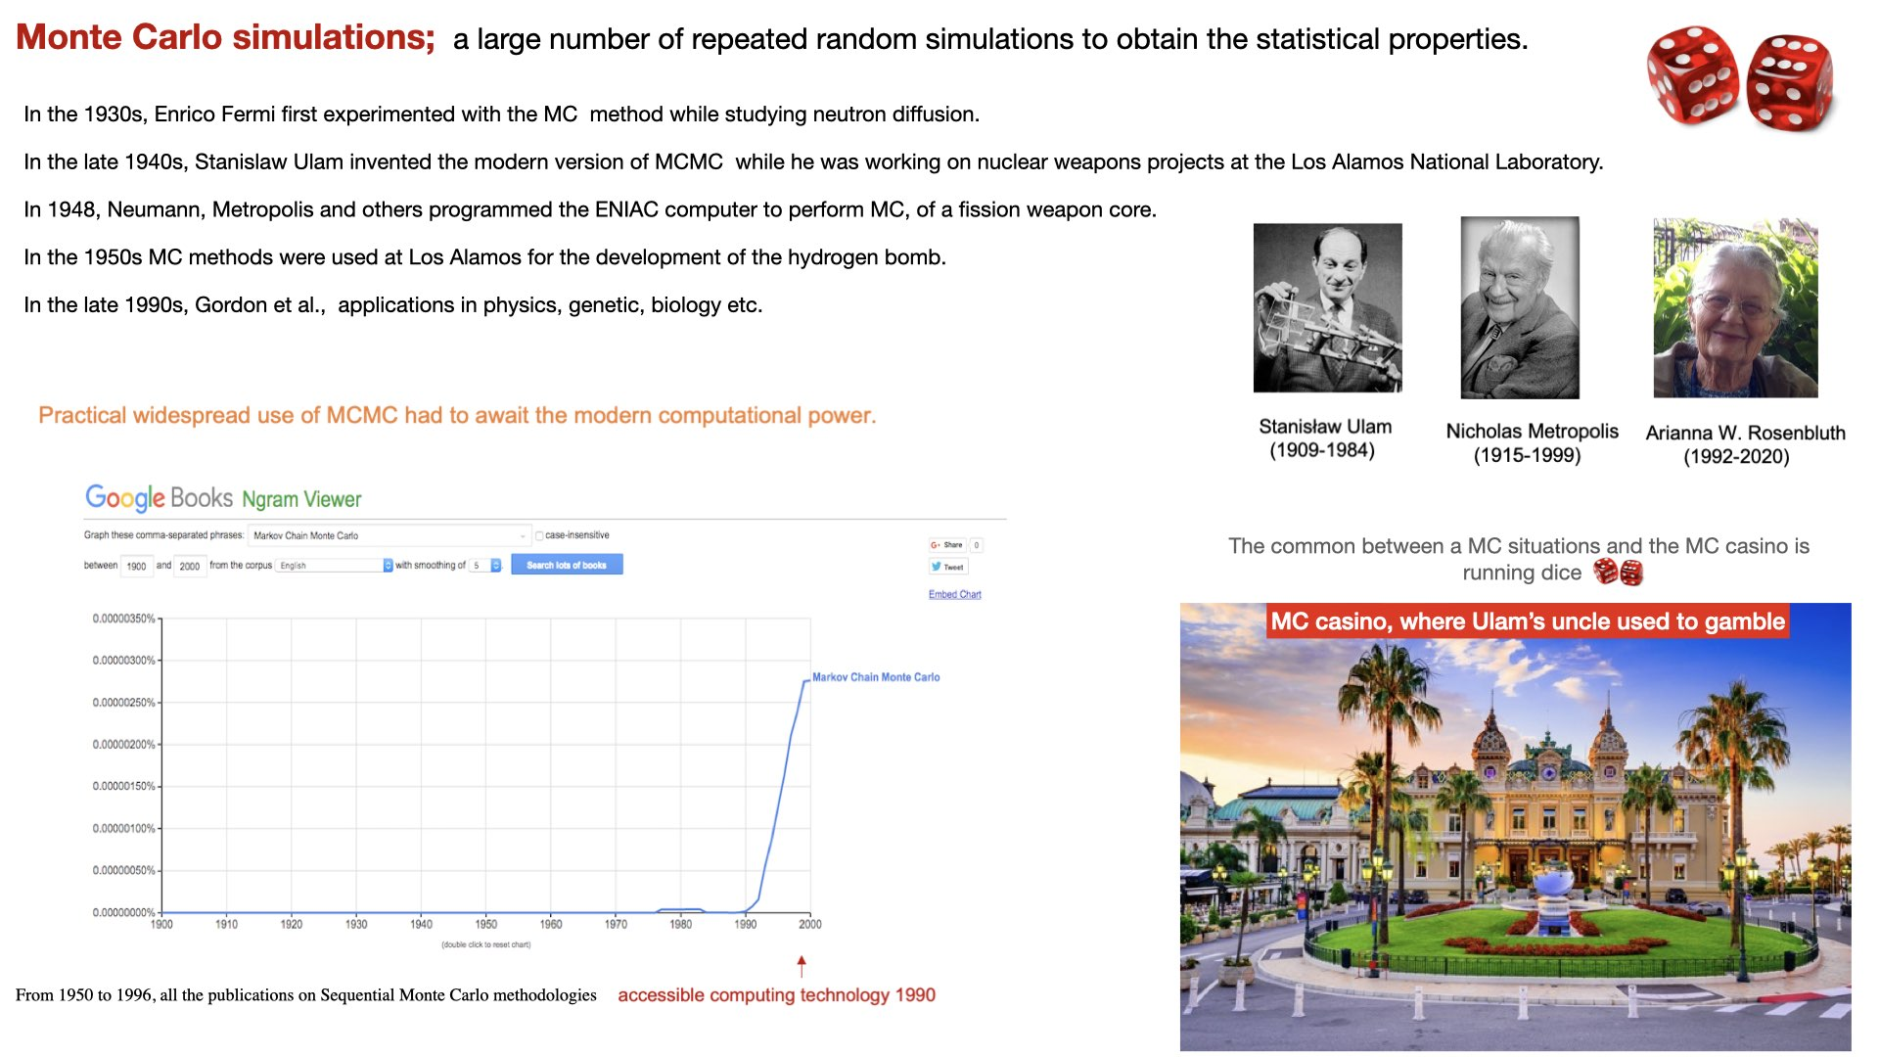
Notes:
Image fro left to right :
Nicholas Constantine Metropolis (1915-1999)
Stanisław Ulam (1909-1984)
Arianna W. Rosenbluth (first implementation of MCMC in code) 192-2020
In the 1930s, Enrico Fermi first experimented with the Monte Carlo method while studying neutron diffusion, but he did not publish this work.
In the late 1940s, Stanislaw Ulam invented the modern version of the Markov Chain Monte Carlo method while he was working on nuclear weapons projects at the Los Alamos National Laboratory.
Von Neumann, Nicholas Metropolis and others programmed the ENIAC computer to perform the first fully automated Monte Carlo calculations, of a fission weapon core, in the spring of 1948.
In the 1950s Monte Carlo methods were used at Los Alamos for the development of the hydrogen bomb,
It was in 1993, that Gordon et al., published in their seminal work[36] the first application of a Monte Carlo resampling algorithm in Bayesian statistical inference (the bootstrap filter; does not require any assumption about that state-space or the noise of the system ).
Being secret, the work of von Neumann and Ulam required a code name. A colleague of von Neumann and Ulam, Nicholas Metropolis, suggested using the name Monte Carlo, which refers to the Monte Carlo Casino in Monaco where Ulam's uncle would borrow money from relatives to gamble
Monte-Carlo trolley, or FERMIAC: was an analog computer invented by physicist Enrico Fermi to aid in his studies of neutron transport

Slide 32
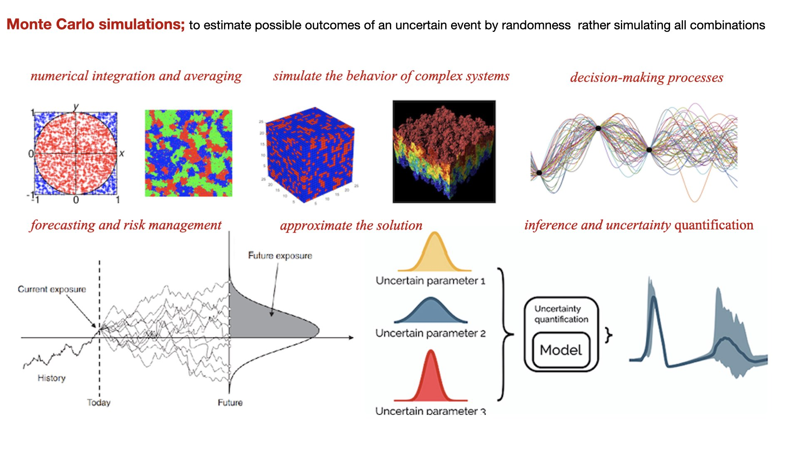
Notes:
Advantages: generate multiple possible outcomes and calculate the average result.
Integrate subject specific information and prior predictive check
Estimation of posterior (reliability for causal inference/prediction)
Statistical relation between parameters (identifiability/degeneracy)
model selection, comparison and hypothesis evaluation from evidence
Challenges:
High-dimensional parameter spaces involving correlated variables
Geometry of the target distribution and its curvature
Computationally expensive (likelihood evaluation)
Sensitivity and Convergence (sample mixing)
Task-dependent algorithm
Hyperparameter tuning

Slide 33
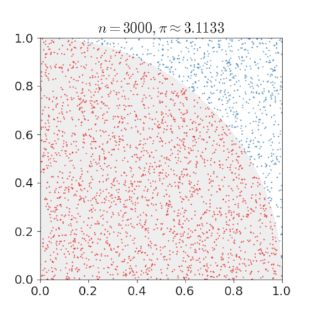
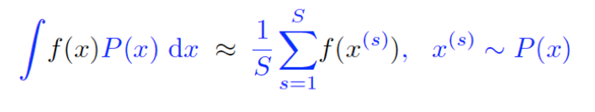
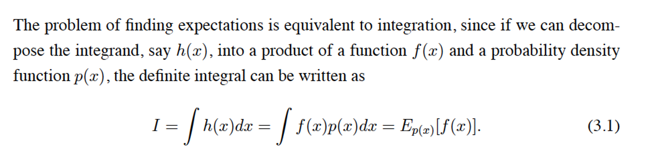
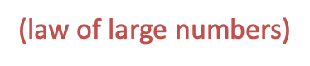
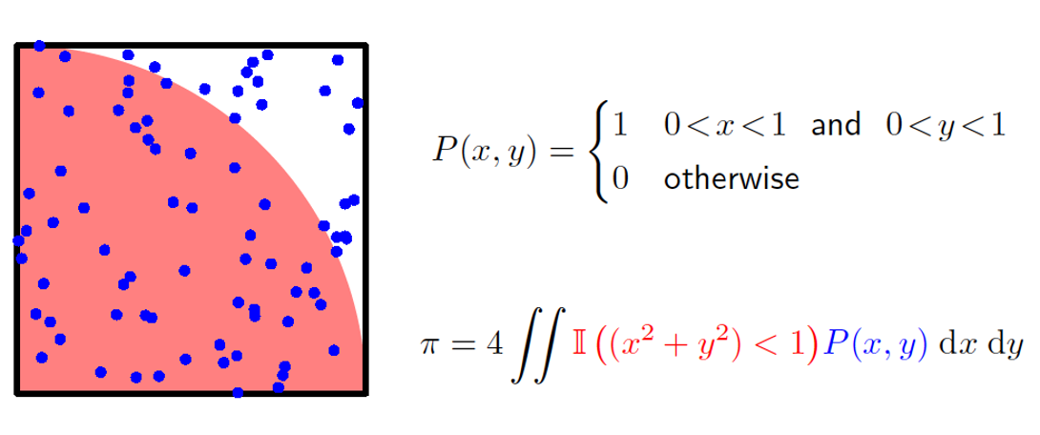
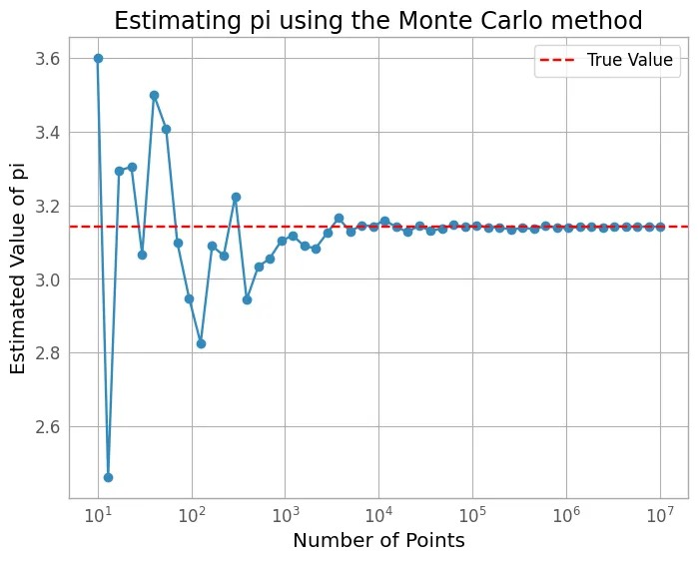
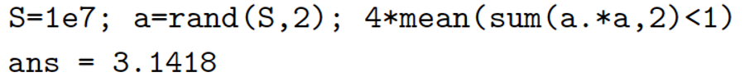
Monte Carlo Principle; Integration=Expectation; any expectation can be calculated with random sample
Consider a quadrant (circular sector) inscribed in a unit square. Given that the ratio of their areas is π/4
Uniformly scatter a given number of points over the square
# no. of points inside quarter of circle
π/4 <1
=
# no. of points inside square
Count the number of points inside the quadrant, i.e. having a distance from the origin of less than 1
The integration = The expectation of function f(x), with respect to a distribution P(x):
Notes:
LLN: According to the law, the average of the results obtained from a large number of trials should be close to the expected value and tends to become closer to the expected value as more trials are performed.
Law of Large numbers says that sample average converges towards the expectation.
import random
# Function to estimate the value of pi using Monte Carlo methods
def estimate_pi(num_samples):
num_inside = 0
for i in range(num_samples):
x = random.uniform(-1, 1)
y = random.uniform(-1, 1)
if x**2 + y**2 <= 1:
num_inside += 1
pi_estimate = 4 * num_inside / num_samples
return pi_estimate
# Estimate the value of pi using 10,000 samples
pi_estimate = estimate_pi(10000)
print("Estimated value of pi:", pi_estimate)

Slide 34
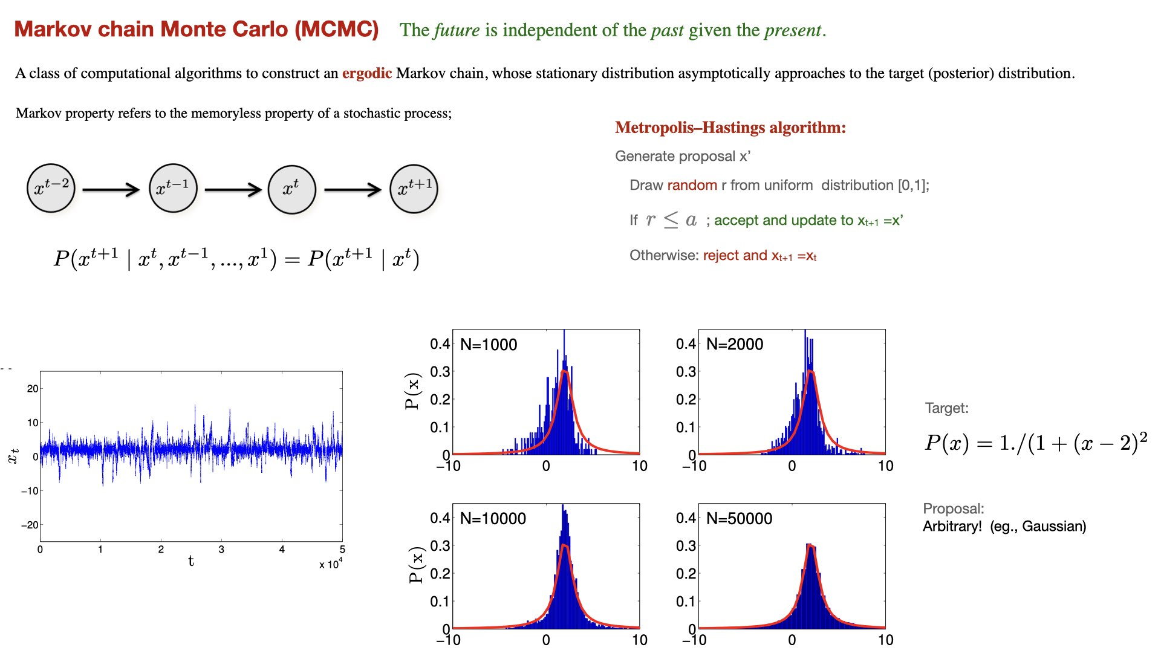
Notes:
Ergodicity is where the ensemble average equals the time average
One of the most 10 influential algorithms in 20th cent
We draw samples from a (simple) proposal distribution so that each draw depends only on the state of the previous draw (Markov property). Under certain conditions, the Markov chain will have a unique stationary distribution, which converge to proposal distribution.
he term Markov chain refers to a sequence of stochastic states such that the transition probabilities from one state to another depends only on the previous state of the chain:
At each iteration, a sample candidate is drawn from an arbitrary proposal distribution,
which determines the next sample value based on the current sample value. In other word, a
trial transition to a candidate state is proposed randomly from the present state. Then,
the candidate sample is either accepted or rejected with some probability a .
the most commonly used MCMC method for obtaining a sequence of random samples from a probability distribution is Metropolis-Hastings (MH) algorithm.
An attractive property of the Metropolis algorithm is that the target distribution does not have to be a properly normalized probability distribution. This is due to the fact that the acceptance probability is based on the ratio of two values of the target distribution.
Existence of stationary distribution: there must exist a stationary distribution π ( x ) \pi (x). A sufficient but not necessary condition is detailed balance, which requires that each transition x → x ′ {\displaystyle x\to x'} is reversible: for every pair of states x , x ′ {\displaystyle x,x'}, the probability of being in state x x and transitioning to state x ′ x' must be equal to the probability of being in state x ′ x' and transitioning to state x x, π ( x ) P ( x ′ ∣ x ) = π ( x ′ ) P ( x ∣ x ′ ) {\displaystyle \pi (x)P(x'\mid x)=\pi (x')P(x\mid x')}.
Uniqueness of stationary distribution: the stationary distribution π ( x ) \pi (x) must be unique. This is guaranteed by ergodicity of the Markov process, which requires that every state must (1) be aperiodic—the system does not return to the same state at fixed intervals; and (2) be positive recurrent—the expected number of steps for returning to the same state is finite.

Slide 35
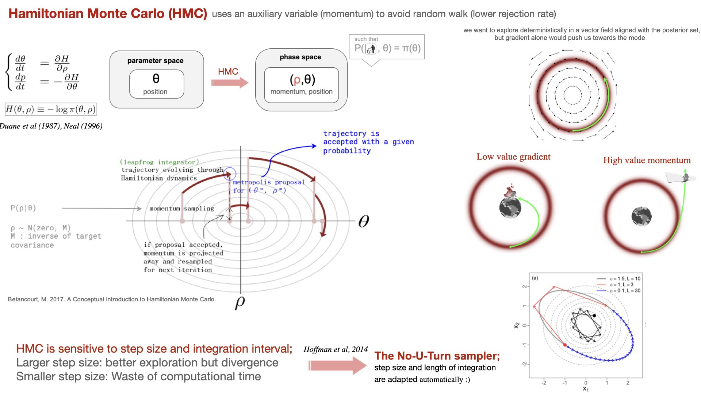
Notes:
HMC augments the space explored by the markov chain from the parameter space, to phase space by introducing an auxiliary momentum rho, then we are able to evolve the resulting momentum and position deterministically by following and integrating the hamilton equations of motion
the momentum is projected away as it serves only as an artificial helper
this phase of deterministic exploration helps achieving more pertinent transitions and thus more efficient exploration of the parameter space
Energy levels sets that have the same value of the Hamiltonian, as it is energy conserving system
First the artificial momentum is sampled from a distribution conditional or not to the position in parameter space
then the couple is evolved deterministically through hamiltonian dynamics, and the trajectory is subjected to an accept-reject step as in most MCMC methods to correct for biais
If accepted, we project and the chains has evolved in the parameter space
In practice the hamiltonian flow is simulated by a numerical integrator: the most used is the leapfrog integrator that alternates update of half a step on momentum , full update on param, and then another half update on momentum
The performance of the resulting integration and the whole algorithm is highly sensitive to the choice of the step size for the integration. The step size should be small enough so that we don’t make numerical errors, but large enough so that it’s not too slow. The length of the trajectory should be in accordance with the step size.
In the fanciest implementations of HMC, step size and length of integration are adapted automatically. By making the system reversible, by evolving the system backward and forwards in time, they rely on construction a balanced binary tree whose depth will stand for the length and is managed by the No-U-turn criterion and a new hyperparameter in case the criterion is never met. The reversibility also makes it possible to define a target acceptance probability which will influence the step size.

Slide 36
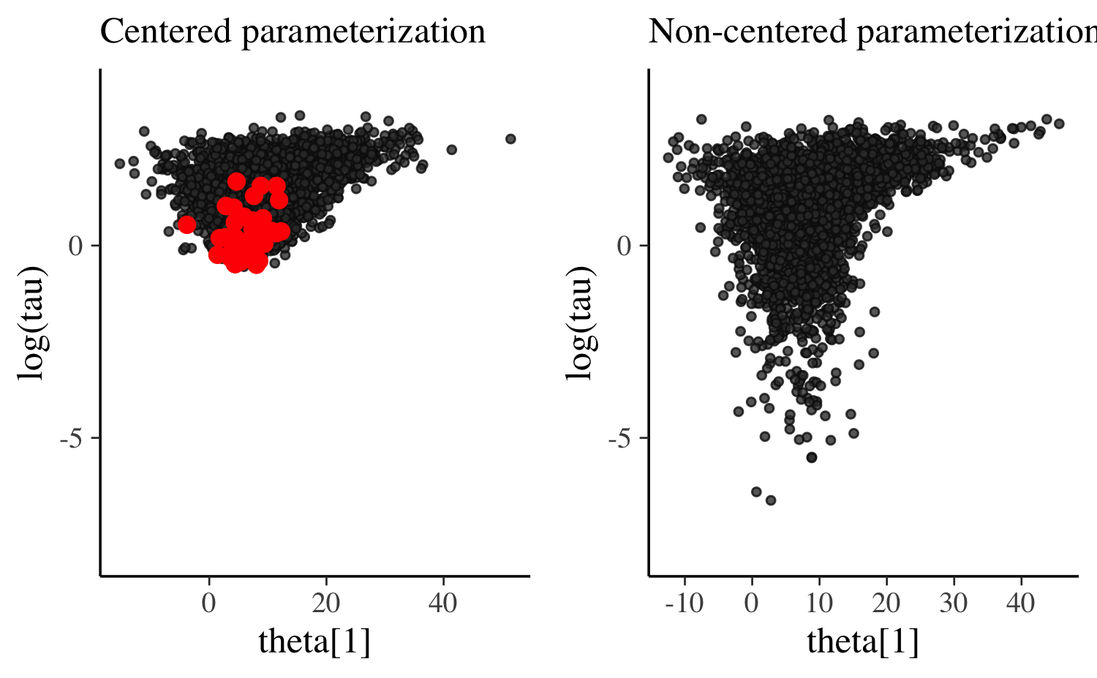
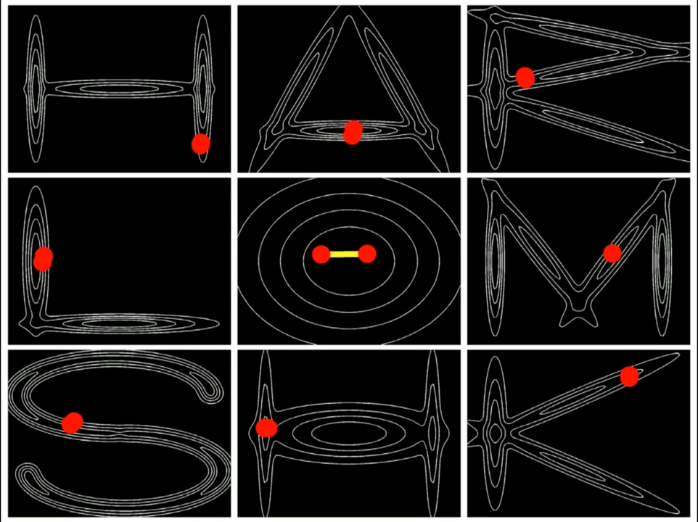
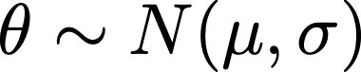
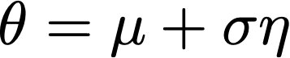


No-U-Turn Sampler (NUTS): self-tuning variant of HMC
Re-parameterization
NUTS: The no-u-turn sampler: Adaptively setting path lengths in HMC (Hoffman, M.D., Gelman, A., JMLR 2014)

Slide 37

Notes:
In mean-field approximation, it assumes that the posterior distribution can be factorized into independent distributions over the model's variables. It is a simplifying assumption where each variable is treated as independent of the others.
Laplace approach approximates the posterior distribution using a Gaussian distribution, often centered at the mode of the true posterior

Slide 38






Kullback–Leibler (KL) divergence: measure of the difference between two probability distributions.(relative entropy; expected surprise)
a measure of how one probability distribution P is different from reference Q.
KL is asymmetric divergence
(not a distance metric)
Forward KL; mass-seeking
Reverse KL; mode-seeking
Notes:
KL is divergence not a distance metric (positive define and symetric)
KL: how much information we lose when we choose an approximation
KL is the expectation of the logarithmic difference between the probabilities P and Q ;
how many bits of information we expect to lose
Joint entropy - reference entropy

Slide 39

Notes:
Model Evidence: How well the data is explained by the model
Or The level of information gained by belief updating
Evidence: Empirical data or observable information that can be used to support or reject a hypothesis.
ELBO depends only on proposals q, and log p is fixed (does not depend on q).
The principle of maximum entropy suggests that, among the beliefs that are compatible with the observation, we should choose the most “unbiased” belief, in the sense that it corresponds to a maximum number of possible assignments of the hidden variables.
Free energy= Expected (negative) energy + Shannon Entropy
Ln P(y)=Ln int P(y, \theta) d\theta
That means that if we can express ln P(y) as the average of a log, then to construct a lower bound we simply need to rearrange terms to get the log of an average
Any point on the secant line, such as y_A, is a weighted average of f(x_1) and f(x_2):
y_A=af(x_1)+(1-a)f(x_2).
Jensen's inequality says that this average-of-functions will always be less than or equal to the corresponding function-of-the-average:
y_B=f(ax_1+(1-a)x_2), Thus, using the notation of expected values,
E(f(x)) < f(E(X))
a system tends to its state with maximum entropy at the largest rate. According to the Second Law of Thermodynamics a spontaneous change results in an increase in the entropy of the universe. In an isolated system, when the system's entropy reaches the maximum, the system stays there because any further change would reduce entropy. That's obviously the equilibrium position

Slide 40

Notes:
More similarities, more entropy, as we increase the difference, we lower the entropy.
Under ergodic assumptions, the long-term average of surprise is entropy
A probability density Q(θ) with high entropy will
be smooth (or in the limit, flat) over the possible values of θ, whereas a
probability density with low entropy will have peaks around particular
values. This means that if we have two candidate Q(θ) densities, both
equally likely under the priors, to maximize the free energy we would
select the one that is smoother or, equivalently, with the higher entropy.
This is referred to as Jaynes’ Principle of Maximum Entropy (Jaynes,
1957), and means that we select the simplest explanation for the data
where possible.
According to the maximum entropy principle, the best guess is the one which maximises the information entropy under the given constraints.
The principle of maximum entropy states that the probability distribution which best represents the current state of knowledge about a system is the one with largest entropy,
The second law of thermodynamics states that the total entropy of a system either increases or remains constant in any spontaneous process; it never decrease
The Principle of Maximum Entropy is based on the premise that when estimating the probability
distribution, you should select that distribution which leaves you the largest remaining uncertainty (i.e., the maximum entropy) consistent with your constraints.
The larger std, the larger entropy. In this context, we maximize entropy to represent a more unbiased or less informative probability distribution.
the probability distribution which has maximum entropy is the only unbiased choice to be mad

Slide 41

Notes:
Friston Free energy =-logP=-ELBO=-Variational Free energy
Under ergodic assumptions, the long-term average of surprise is entropy.
Slef-organized systems resist the natural tendency to disorders.
F: an information theory measure that upper bounds (is grater than) the surprise on sampling some data (sensory inputs), given a generative model.
The free energy principle is a theoretical framework suggesting that the brain reduces surprise or uncertainty by making predictions based on internal models and updating them using sensory input.
free energy is the maximum amount of surprise an organism can experience upon arriving at some new evidence or sensory data, or more specifically, it is the upper bound on that surprise!
The free energy principle is a theoretical framework suggesting that the brain reduces surprise or uncertainty by making predictions based on internal models and updating them using sensory input
https://www.kaggle.com/code/charel/learn-by-example-active-inference-in-the-brain-1
free energy, in thermodynamics, energy like property or state function of a system in thermodynamic equilibrium.
Active inference is a theory that characterizes perception, planning, and action in terms of probabilistic inference.
biological agents resist a tendency to disorder and therefore minimize the entropy of their sensory states
Enropy=Average Surprise
Enropy=𝔼{Surprise}
Enropy=𝔼{−lnP(S)}
Surprise rests on predictions about sensations
F ≥ −lnP(S)
‘free energy’ is an upper bound on surprisal,
surprise is the negative natural logarithm of the probability of the observed outcome:
S=−ln P(X=x)
Free energy is the surprisal an organism experiences upon sampling some data, given a generative model.
Free energy is an upper bound on surprisal! F> -ln P(y)
Free energy is the surprisal an organism experiences upon sampling some data, given a generative model
free energy represents the difference between the brain's predictions and sensory inputs.
Note that the free energy is sometimes defined to be the negative of this quantity.
In Friston's framework, the concept of "free energy" is related to the brain's role in minimizing surprise or uncertainty about its sensory inputs and maintaining a stable internal model of the world.
In Friston's theory, the brain is seen as a system that tries to minimize its "free energy," which represents a combination of prediction error and uncertainty in its internal model. This minimization process, according to the Free Energy Principle, leads to adaptive behavior and the brain's ability to generate predictions and take actions to reduce surprise or maintain internal stability.
Surprise or self-information is the negative log probability of an outcome.
The Helmholtz free energy, A, is defined as:
F = U - TS
Helmholtz free energy is a measure of the energy available to do useful work in a system, considering that some of the internal energy (U) may be unavailable due to the system's entropy (S) at a given temperature (T).
The total free energy during a spontaneous change can only decrease. So we minimise entropy as a way to reduce uncertainty or make a system more predictable.
Gibbs free energy, also known as Gibbs energy, or free energy, is a quantity used to quantify the overall amount of work performed in a system when temperature and pressure remain constant.
The change in Gibbs free energy (ΔG) equals zero when a system is at equilibrium. At equilibrium, the system has reached a state of balance where the forward and reverse reactions occur at the same rate, and there is no net change in the concentrations of reactants and products over time.
Gibb's free energy is negative when the reaction is spontaneous at a particular temperature, and positive when the reaction is non-spontaneous.
Active inference: internal states appear to infer the hidden causes of their sensory states (by increasing model evidence) and actively influence those causes
https://mundyreimer.github.io/blog/free-energy-principle

Slide 42





Approximate Bayesian Computation (ABC)
prior
proposal
simulator
compare
data
posterior
exact only if
Curse of dimensionality
Sensitivity to thresholding

Slide 43


Slide 44


Slide 45
Practical examples

Slide 46


Slide 47

Notes:
\footnotetext{Three population parameters $(CL_{pop}, V_{pop}, {k_a}_{pop})$ and their respective variability $(\omega_{CL}, \omega_{V}, \omega_{k_a})$; $3 \times 67$ individual parameters $\lbrace CL_i, V_i, {k_a}_i\rbrace_{i=1}^{N=67}$; elements of $3\times3$ Cholesky matrix $\mathbf{L}$; $3 \times 67$ standard normal variables for non-centered parametrization of Eq. \eqref{eq:distrib_thetai}; residual variability $\sigma$.}

Slide 48

Notes:
Broadly speaking, mcmc can
Previously,
Most fit are good, fit is almost never a problem
if fit is bad, it is easier to resolve than if fit is already good but posterior is bad
2 kind of methods: do not rely on computing the gradient of the model likelihood and methods that are based on this gradient
Show both the fit to voltage of pyramidal neurons and the posterior parameter inference, in the form of pair plots of parameter 1 g1 and parameter 10 u input
Most simple gradient free methods such as metrop hastings perform poorly
Other gradient free have good fit to the data but posterior samples for the parameters are very very sparse
e.g. for metropolis hastings scheme, it seems they have only 1 identical sample out of 14,000 iterations = terrible
Gradient based methods
Langevin Monte Carlo which is a special case of HMC, that takes into account anisotropy of the likelihood manifold
LMC with euclidian metric is as bad as the non-gradient
The other version of LMC is not bad but still not very efficient
And finally the only method that is efficient enough is Hamiltonian Monte Carlo

Slide 49


Slide 50

Notes:
tedious and does not apply to all models and problematics; It has to be explored again if another model
Avoids the chain to be starting near an non-relevant attraction region
weights and combines the distributions from multiple models
(or chains) to provide more robust inference and enhance predictive performance.
Given K models M1, . . . MK , the weights computed based on stacking of predictive
distributions, are the solution of the optimization problem
where y−i is data without the i-th data point and the leave-one-out predictive den-
sity p(yi | y−i, Mk) can be estimated with delpdpsis-loo.
hanks to this
approximation, readily implemented in the Arviz package (Kumar et al., 2019), the
computation of stacking weights is fast, negligible compared to that of the inference
part

Slide 51


Slide 52


Slide 53


Slide 54


Slide 55






SBI from exact Neural Mass Model of spiking neuron’s
Montbrio et al., PRX 2015
Baldy et al., et al, Neural Compt 2024
https://github.com/ins-amu/Inference_MFM

Slide 56


Slide 57


Slide 58


Slide 59


Slide 60

Hashemi et al., Neural Net 2023

Slide 61

High res made by Paul Triebkorn

Slide 62


Slide 63

Hashemi et al., MLST 2024, Ziaeemehr et al., eLife2025
Notes:
We have also used these techniques to predict the inter-and intra variability in Baclofen administration in AUD. (here plasma concentration shown in red, individual estimated in blue, versus the population average shown dotted black).
In a recent study, we combined DTI with MEG, and we found that in the MS, the inferred velocity was slower in MS patient than control, and this was a better practice of clinical disability, outperforming lesion load.
————————————-
MS is inflammatory disease of human central nervous system (attacks from the immune system to the myelin sheath). The underlying assumption was that patients with greater lesion load would be clinically worse than those with a smaller lesion load. While myelin damage broadly affects conduction speeds, traditional tests focus on specific white-matter tracts, which may not reflect overall impairment accurately. There is No one-to-one correspondence between structure and function.
We integrate DTI and MEG data into personalized models of multiple sclerosi. We then used state-of-the-art deep neural networks for (likelihood-free) Bayesian model inversion to estimate the most likely average conduction velocity in each patient, given the observed spectral features (and the connectomes). Remarkably, these velocities proved superior predictors of clinical disability compared to structural damage.
Expanded Disability Status Scale (EDSS)
——————————————————————-
Alzheimer's disease (AD) is a neurodegenerative disorder characterized by the accumulation of abnormal beta-amyloid (Aβ; extracellular) and hyperphosphorylated Tau (pTau; intracellular), causing an excessive and hypersynchronous neuronal firing that promotes hyperexcitability and leads to brain network dysfunction and cognitive deficit.
Structural brain topographies were combined, either with excitotoxicity, or postsynaptic depression, as two leading mechanisms of the Aβ and pTau on neuronal activity.
We found that the excitotoxicity is sufficient and necessary to reproduce empirical
biomarkers two biometrics associated with AD pathology: homotopic dysconnectivity (due to degeneration of corpus callosum particularly in the temporal-parietal regions) and a
decrease in limbic network dynamical fluidity. There have been findings that tau also
causes hypoexcitability in certain areas of the brain
Neuropathological alterations of Aβ and pTau disrupts synaptic transmission, perturbs excitation/inhibition balance and alters neuronal networks resulting in the excitotoxicity that leads cognitive decline in AD.
Local interventions (thalamic lesion and chemogenetic silencing of
cortical hubs), we demonstrate both local and global effects

Slide 64

Hashemi, Ziaee et al., submitted

Slide 65


Slide 66

Hashemi et al., MLST 2024, Ziaeemehr et al., eLife2025

Slide 67


Slide 68


Slide 69


Slide 70




Codes: https://github.com/ins-amu
ebrains-task-3-3/Drive#notebooks/EITN_tutorial

Slide 71
Appendix

Slide 72


Slide 73

Notes:
HMC takes advantage of gradient information to achieve much faster convergence than traditional sampling methods, and its trajectories do not resemble random-walks.
Hamiltonian Monte Carlo (HMC), also known as hybrid Monte Carlo, is able to suppress such random walk behavior by means of a clever auxiliary
variable scheme that transforms the problem of sampling from a target distribution into the problem of simulating Hamiltonian dynamics.
More advanced techniques, such as Hybrid Monte Carlo have been developed to incorporate additional dynamics that increase the efficiency of the Markov chain path.
For reversibility to be maintained, the total energy of the particle has to be conserved - hence we are interested in Hamiltonian systems.
Hamiltonian dynamics describe an object’s motion in terms of its location and momentum (equivalent to the object’s mass times its velocity) at some time. Hamiltonian dynamics describe how kinetic energy is converted to potential energy (and vice versa) as an object moves throughout a system in time. This description is implemented quantitatively via a set of differential equations known as the Hamiltonian equations:
the above transformation preserves volume and is reversible and can thus be used as transition operators of a Markov chain.
For a given set of initial conditions, Hamiltonian dynamics will follow contours of constant energy in phase space (analogous to the circle traced out in phase space in the example above).
For simpilicity M is taken to be diagonal and often equal to identity matrix.
the canonical distribution for p is independent of the canonical distribution for q
preserve the properties of volume conservation and time reversibility.
In practice, we cannot simulate Hamiltonian dynamics exactly because of the problem of time discretization.
There are several ways one can do this. To maintain invariance of the Markov chain however, care must be taken
to preserve the properties of volume conservation and time reversibility. The leap-frog algorithm maintains these properties and operates in 3 steps:
The Leap Frog method updates the momentum and position variables sequentially, starting by simulating the momentum dynamics over half of step size e/2, then simulating the position dynamics over e, then completing the momentum simulation over another small interval of time e/2.
The algorithm simplifies to the following explicit scheme:
First take one half-step for momentum q
Then take a full step for position p
Then take one final half step for momentum q
Notice that using Leapfrog, the volume is preserved and the trajectory is very stable. In addition the discretization is reversible (it doesn't preserve the Hamiltonian perfectly. The error is very stable and the value of the Hamiltonian at each step oscillates around the true value. When we sample from the potential in our HMC, we will use the acceptance probability to balance out the error in H. ).
If our finite difference scheme was exact, the acceptance ration would be 1 since energy is conserved with Hamiltonian dynamics. However, as we have seen, the leapfrog method does not conserve energy perfectly and an accept/reject step is still needed.
Euler discretization involves directly updating the momentum and position at each time step. Notice that with euler method the volume is not preserved.

Slide 74


Slide 75


Slide 76


Slide 77


Slide 78


Slide 79


Slide 80





(Hu et al., NeurIPS 2020)

Slide 81


Slide 82


Slide 83


Slide 84


Slide 85

Notes:
https://jaredtumiel.github.io/blog/2020/08/08/free-energy1.html
https://mundyreimer.github.io/blog/free-energy-principle

Slide 86

Notes:
thermodynamic free energy= maximum amount of work that the system can perform in a process at constant temperature,

Slide 87


Slide 88

Notes:
https://mpatacchiola.github.io/blog/2021/01/25/intro-variational-inference.html
https://lips.cs.princeton.edu/the-elbo-without-jensen-or-kl/
https://blog.jakuba.net/variational-inference-deriving-elbo/

Slide 89


Slide 90


Slide 91


Slide 92


Slide 93


Slide 94

Notes:
https://jaredtumiel.github.io/blog/2020/08/08/free-energy1.html

Slide 95


Slide 96

Notes:
have specially-defined objects for various common
pymc is more full-featured, and once you get the hang of the decorator syntax for defining variables, distributions, and derived quantities, it is very easy to use. Its performance lagged the other two: the same query took several times longer, despite having optimized objects for sampling from various priors. From what I hear, though, the still-in-alpha PyMC version 3 – a complete rewrite of the package – blows PyMC version 2 out of the water.
pystan is the most difficult of the three to use, but that's because it's not really a Python package. Models are specified not in Python, but in a custom statistical expression language. This language is very powerful, but has a steep learning curve. The ~20sec compilation time for each model is annoying, but I suspect that as models get more complicated and sample sizes grow, this won't seem like such an issue. The fact that Stan is specifically designed for this type of operation, and the fact that all its models compile directly to byte code, makes it seem like a reasonable choice for large, specialized computations.
emcee simply runs an "ensemble" of Metropolis-Hastings samplers in parallel.
Edward is a Python library for probabilistic modeling, inference. It enables black box inference for models with discrete and continuous latent variables, neural network parameterizations, and infinite dimensional parameter spaces.
Edward is built on TensorFlow (An open-source software library for numerical computation and for Machine Intelligence).

Slide 97


Slide 98


Slide 99


Slide 100


Slide 101
The end!

